Slide 1
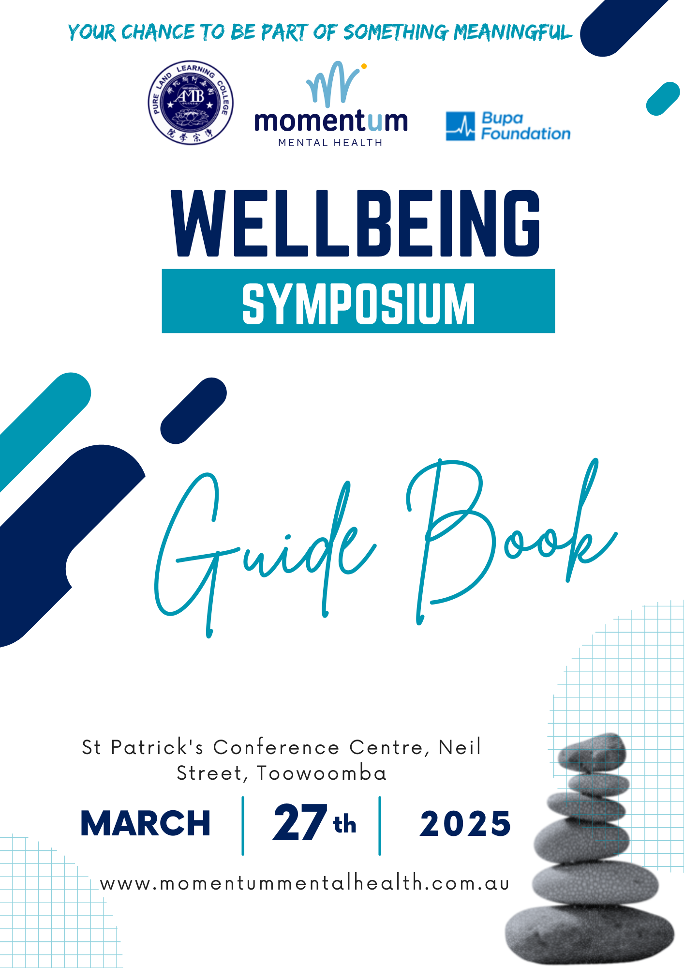


Slide 2











WELLBEING
SYMPOSIUM
SPONSORS
Raffle and Lucky Door Prize Sponsors
Thanks to Our Speaker and Gift Bag Sponsors

Slide 3
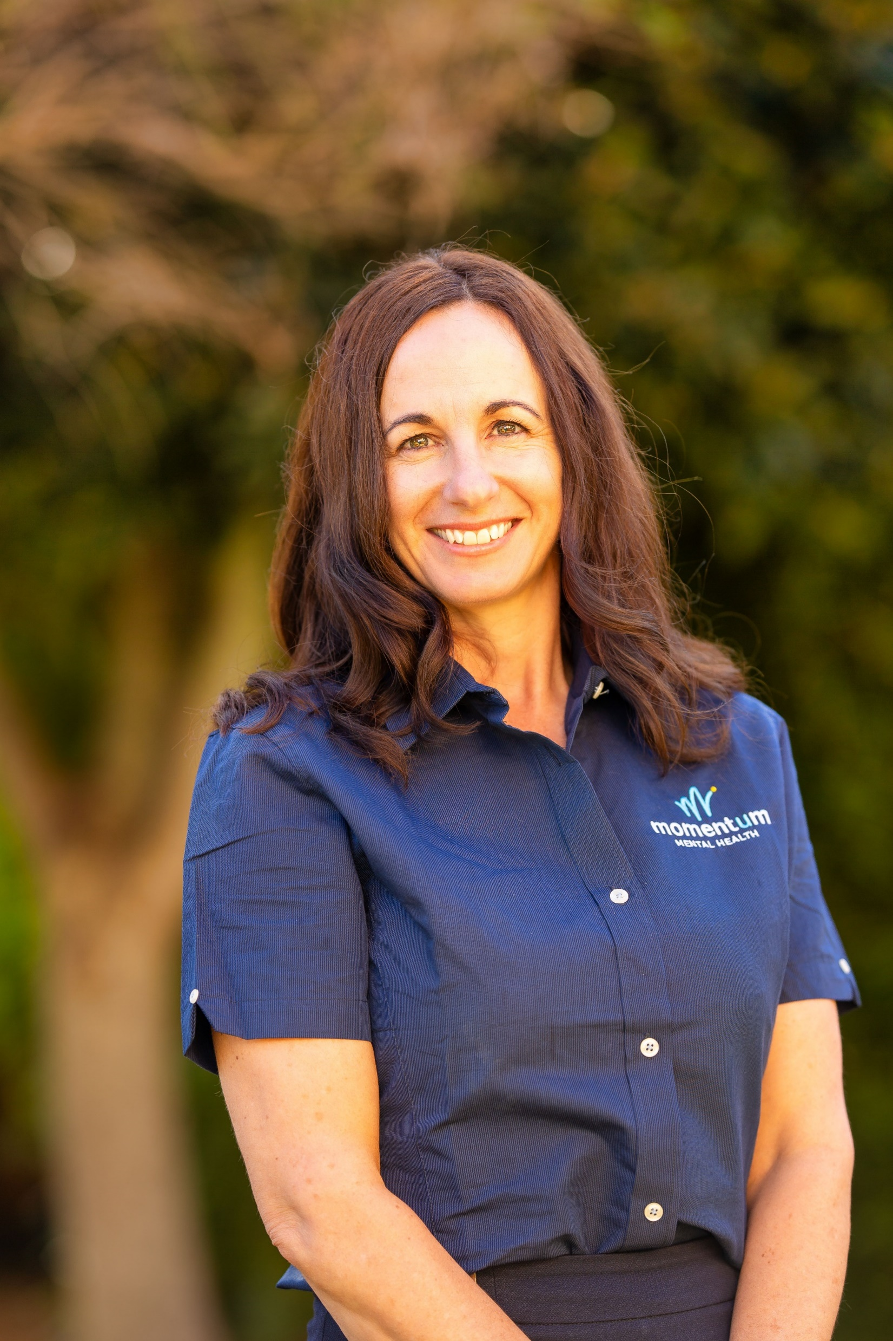
WELLBEING
SYMPOSIUM
WELCOME
Welcome to the Wellbeing Symposium
From the CEO of Momentum Mental Health
It is my absolute pleasure to welcome you all to this incredible Wellbeing Symposium. Today, we come together as a community to learn, connect, and inspire each other in our shared commitment to mental health and wellbeing. This event has brought together over 13 dynamic speakers, more than 35 dedicated stallholders, and an incredible 170 community members and leaders. Toowoomba is an incredibly generous and compassionate community, and today’s gathering is a testament to that spirit.
This event would not have been possible without the generous support of the Bupa Foundation and the dedicated staff from Momentum Mental Health. As a small not-for-profit, we are deeply grateful for the funds raised through ticket sales, which will go directly back into our organisation. These funds will allow us to continue providing free mental health and wellbeing support to anyone over the age of 16 in Toowoomba and across six other locations in the Darling Downs.
Shirley-Anne Gardiner
CEO, Momentum Mental Health
Symposium Organiser
A special and heartfelt thank you must also go to Pure Land Learning College. I have had the privilege of working with Pure Land for several years now, and their generosity never ceases to amaze me. Haniff Abdul Razak, the Director of the College and the Multi-Faith Multicultural Centre, is a truly humble and inspiring leader. I would like to take a moment to share just a glimpse of his remarkable journey.
Haniff Abdul Razak began his career in the Singapore Armed Forces, where he graduated as a Commissioned Officer and served until 1993, when he chose to dedicate himself to community work. Over the years, he has played a pivotal role in multiple organisations, including the Islamic Religious Council of Singapore, where he managed the administration of 69 mosques. One of his most significant achievements was developing and launching the Harmony Centre Singapore, a pioneering initiative for interfaith and cultural engagement, which was inaugurated by the Prime Minister of Singapore.
Beyond his work in Singapore, Haniff has made global contributions. He has served as an Election Supervisor for the United Nations in Namibia and as a Military Liaison Officer in Brunei. His journey eventually led him to Toowoomba in 2010, when he was invited by the esteemed Venerable Master Chin Kung AM to establish the Multi-Faith and Multicultural Centre. Haniff’s tireless dedication to community harmony has been widely recognised, earning him a place among Toowoomba’s 100 most influential community members and the prestigious Paul Myatt Safer City Award in 2018.
In addition to his many roles, Haniff also serves on the Queensland Police Multicultural Advisory Group, further demonstrating his commitment to inclusivity and social cohesion. His contributions remind us of the power of community and the impact that one dedicated individual can make in fostering understanding, peace, and collaboration.

Slide 4
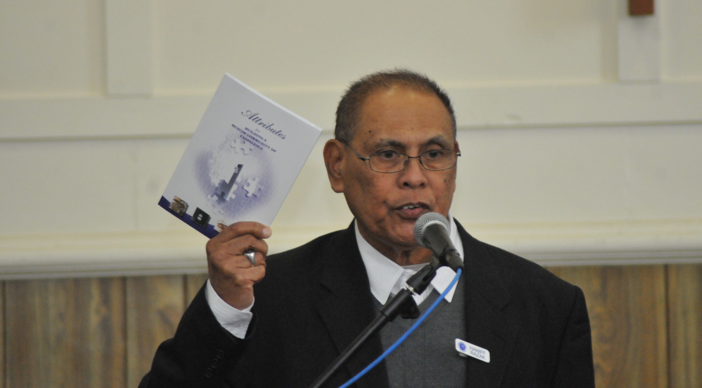
As we embark on this incredible day together, I encourage you all to take full advantage of the insights shared by our speakers, the valuable resources offered by our stallholders, and the connections you will make with fellow attendees. Together, we are building a stronger, more resilient community that prioritises mental health and wellbeing for all.
We are also privileged to welcome an outstanding lineup of speakers, each of whom brings a wealth of knowledge, passion, and experience. Adam and Susy Wenitong, founders of Adapt Mentorship and Consultancy, have been transforming the lives of at-risk youth since 2014 and were honoured as the 2025 Toowoomba Australia Day Indigenous Citizens of the Year. Col Ryan, a dedicated community services professional, has spent over a decade supporting individuals through AOD programs, youth mentoring, and his vital role as Welfare Coordinator at Winter Shelter Toowoomba.
Professor Tracy Kolbe-Alexander, Associate Head of School (Research) at UniSQ’s School of Health and Medical Sciences, is a leader in innovative health interventions, using community-based research to drive positive change. Dr. Uma Kumar, a highly respected GP, Heartfulness Volunteer, and former Toowoomba Hospital Foundation Board Member, has dedicated over two decades to promoting peace and wellbeing. Dr. Raelene Ward, an award-winning Aboriginal scholar and advocate, has conducted groundbreaking research on suicide prevention and crisis support within Aboriginal communities.
Dr. Geoff Woolcock, Senior Research Fellow at UniSQ’s Institute for Resilient Regions, is a driving force in community-based research, focusing on youth-friendly environments and social impact. Finally, Dr. Clive Williams, a psychologist with over 40 years of experience and a Board Member of Momentum Mental Health, is a national and international voice on men’s mental health and change processes.
With such an inspiring group of speakers, I know today will be filled with valuable discussions, thought-provoking insights, and opportunities to connect. Thank you for being part of this journey with us.
Shirley-Anne Gardiner
CEO, Momentum Mental Health
Haniff Abdul Razak
Director
Multifaith Multicultural Centre, Pure Land Learning

Slide 5
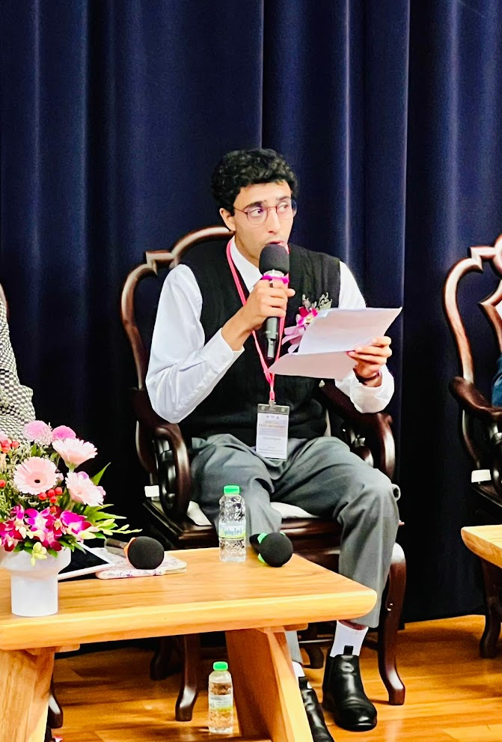



WELLBEING
SYMPOSIUM
MC
Introducing Symposium Master of ceremonies (MC)
Sarmad Bajwah
Sarmad Bajwah has been part of the Toowoomba Youth Peace Group for the past three years and currently has the privilege of serving as its president.
Throughout his journey, he has been actively involved in organising and facilitating youth events and conferences within the community, working to create spaces where young people can connect, grow, and make a difference.
One of the most memorable moments in his peacebuilding journey was flying to Malaysia to present at the International Interfaith Peace and Harmony Forum, where he had the chance to share the work of the youth group on an international stage.
Beyond his community work, Sarmad is pursuing a Bachelor of Mechanical Engineering at the University of Southern Queensland. With a deep passion for leadership and youth empowerment, he is committed to driving positive change with the youth of our community.
Thanks to Our Speaker and Gift Bag Sponsors

Slide 6
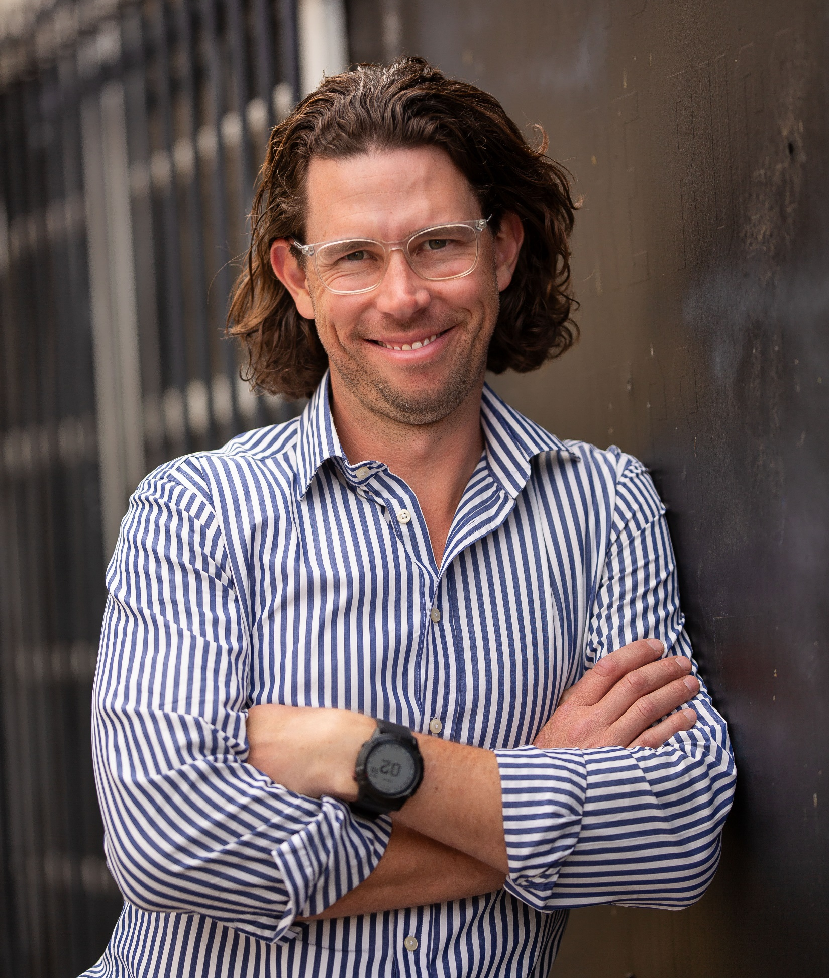
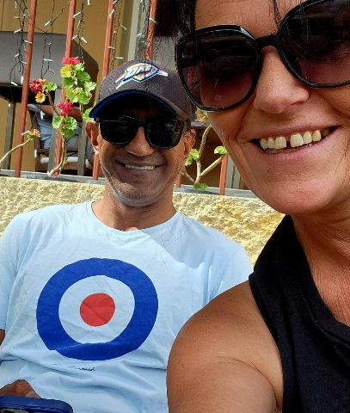
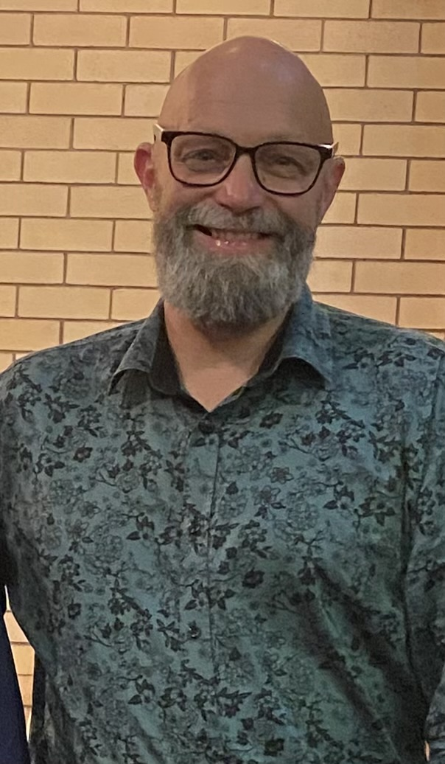
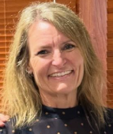
WELLBEING
SYMPOSIUM
PROGRAM
Early Morning Session
Time | Topic | Presenter
8:30am | Registration | Visit stalls and tables
9am | Welcome |  |  | Sarmad Bajwah MC
 | Introduction |  |  | Chris Black Momentum Mental Health Board
9:10am | Acknowledgement of Country |  |  | Susy and Adam Wenitong Adapt Mentorship
 | Importance of wellbeing for children and young people
9:30am | Wellbeing for vulnerable people |  |  | Col Ryan Community Advocate
9:50am | Wellbeing for families and carers |  |  | Terri Bromley Drug Arm
10:10am | Morning tea | Visit stalls and tables

Slide 7
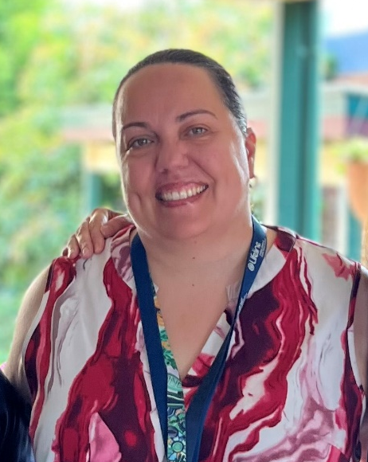
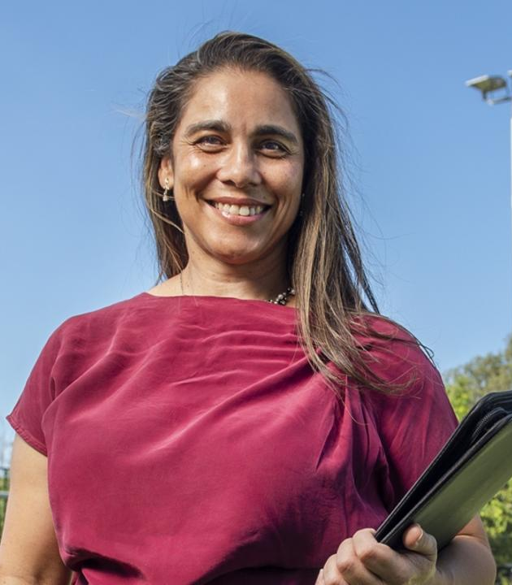
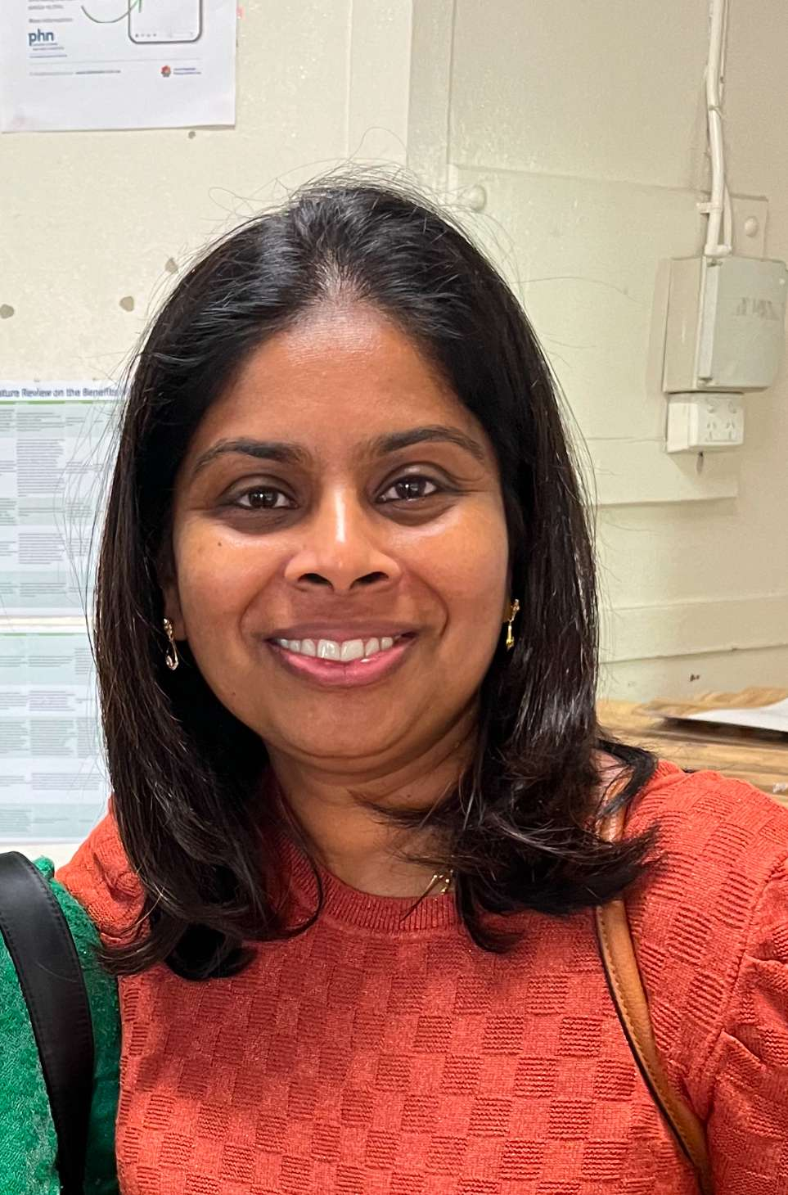


WELLBEING
SYMPOSIUM
PROGRAM
Late Morning Session
Time | Topic | Presenter
10:30am | Gambling and Gaming Awareness |  | Mandy Young Lifeline
10:50am | Your post code matters: Role of the built and natural environment on wellbeing |  | Prof. Tracy Kolbe-Alexander UniSQ
11:10am | Developing resilience through meditative practices |  | Dr Uma Kumar Heartfulness Institute
11:30am | Quick tips to deal with financial stress |  | Raelene Martin Good Shepherd
11:40am | Introduction to the 5 Ways to Wellbeing |  | Shirley-Anne Gardiner Momentum
11:50 | Group Photo 📷

Slide 8

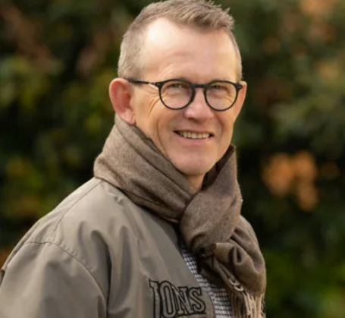
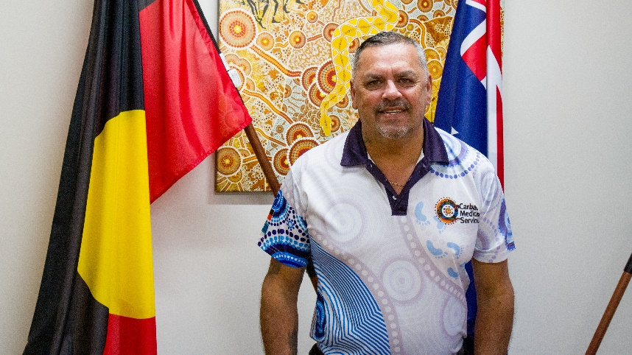

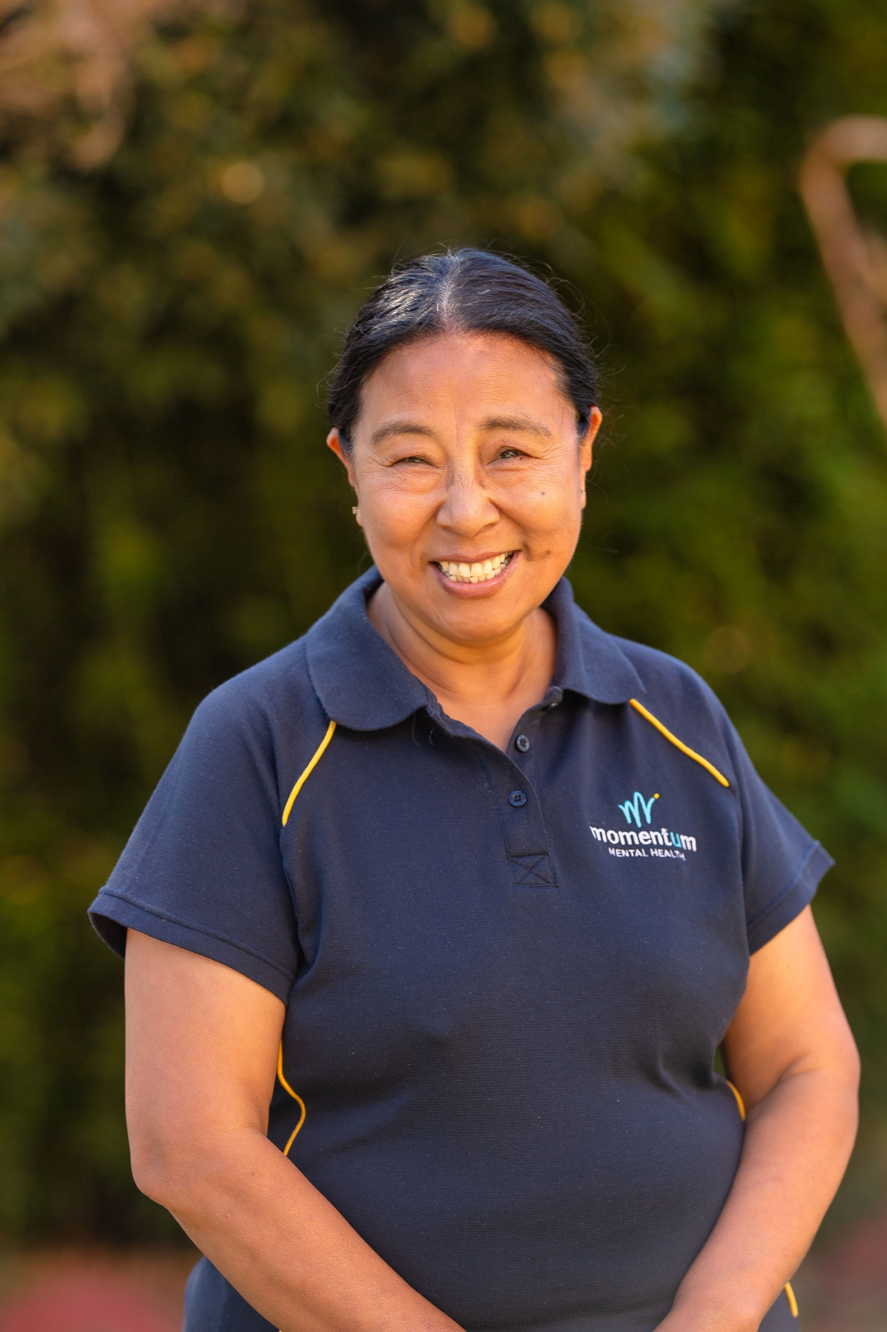
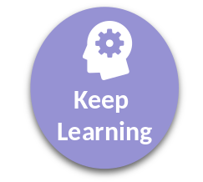
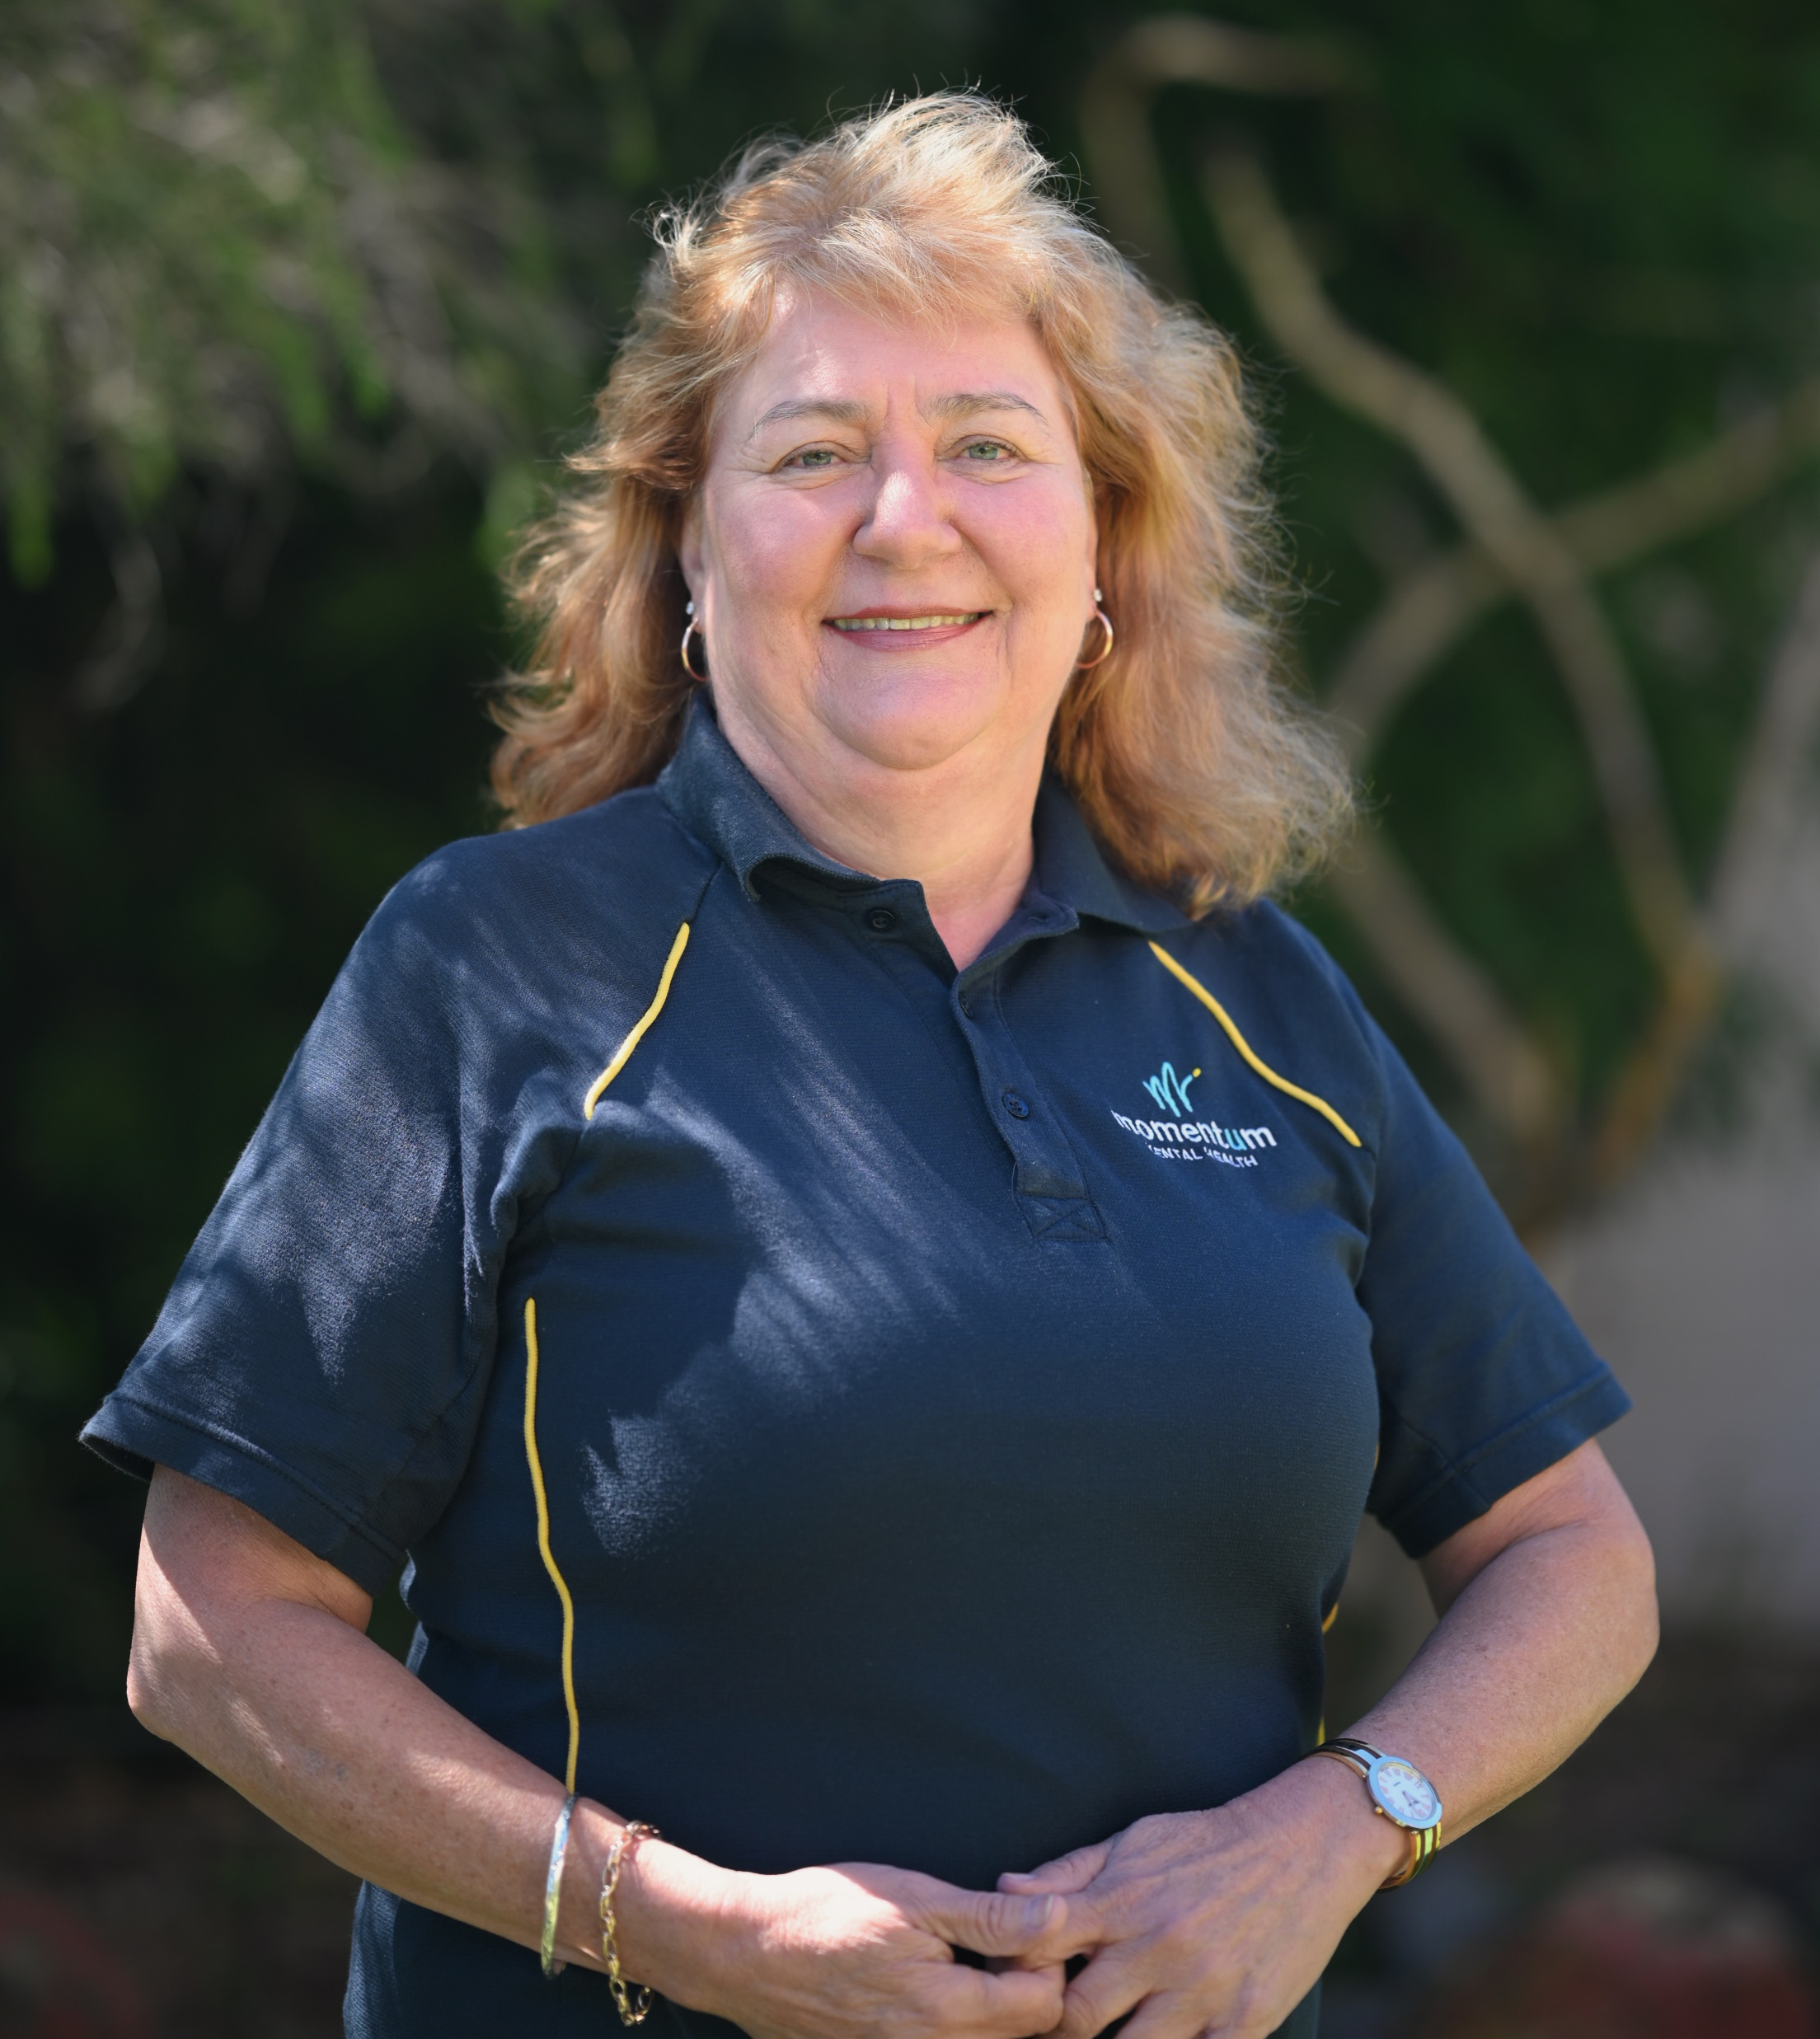
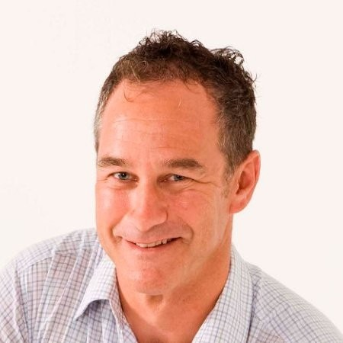
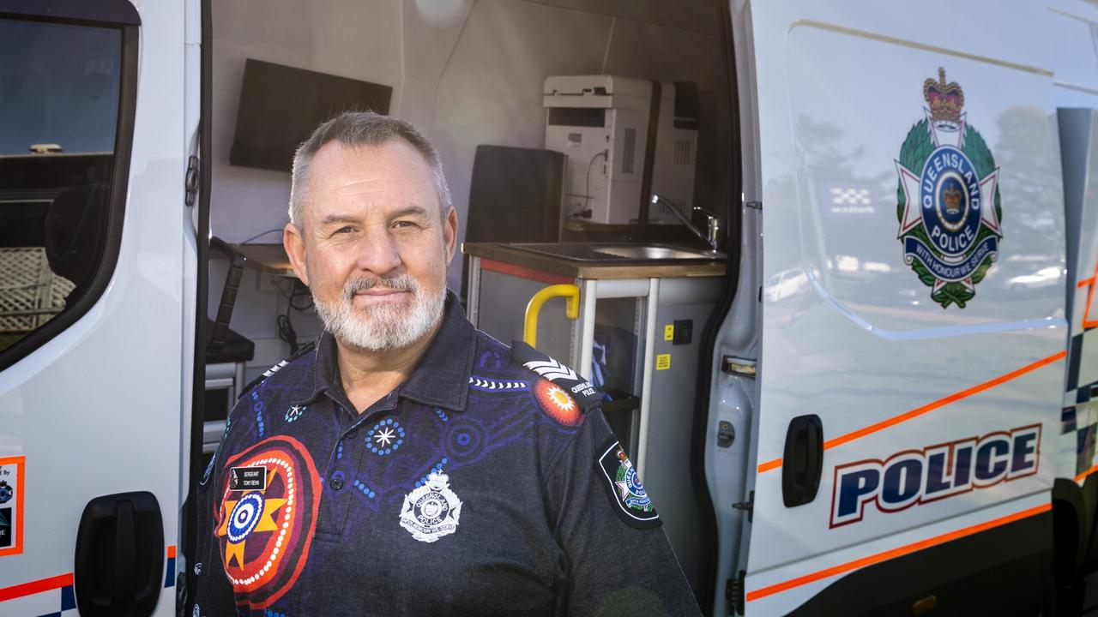


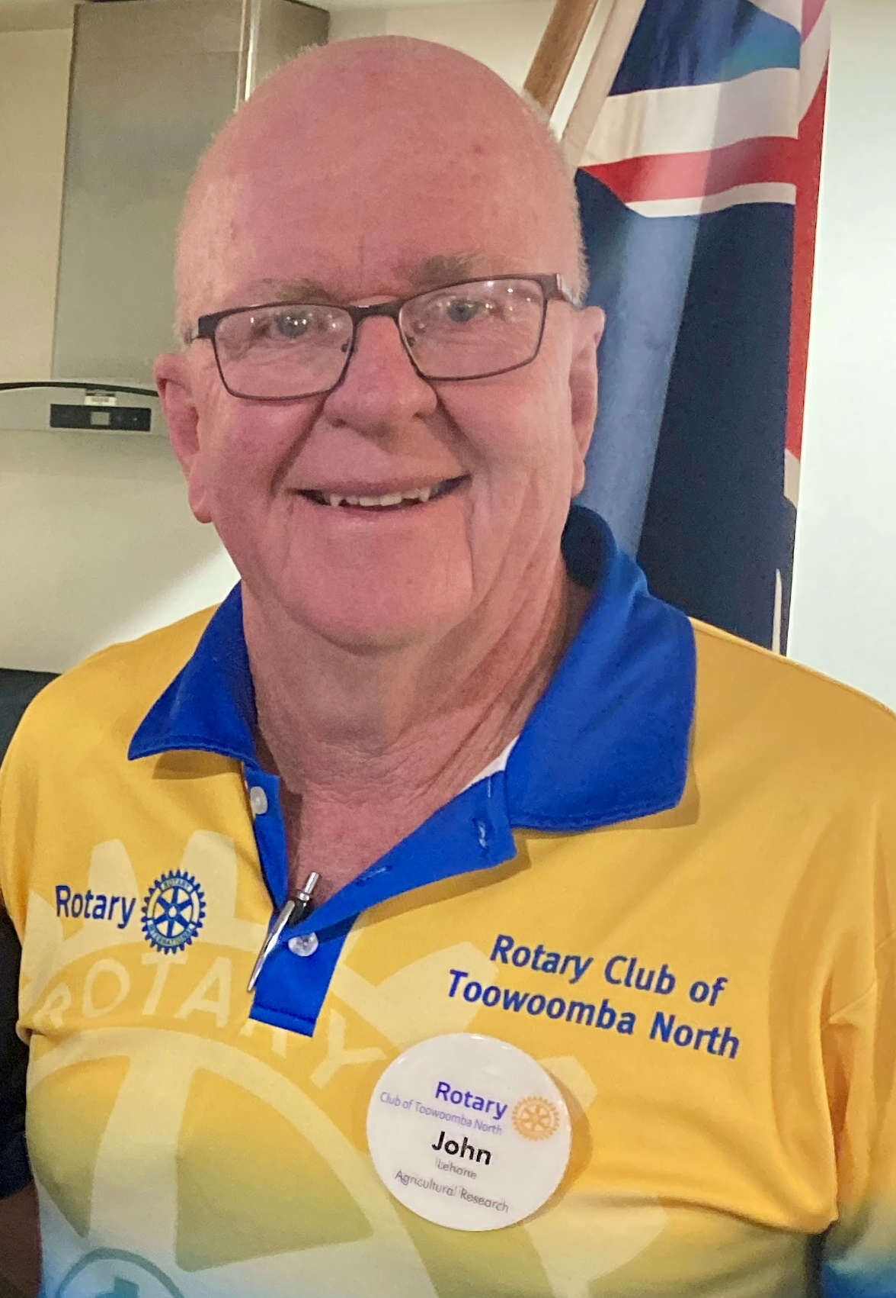
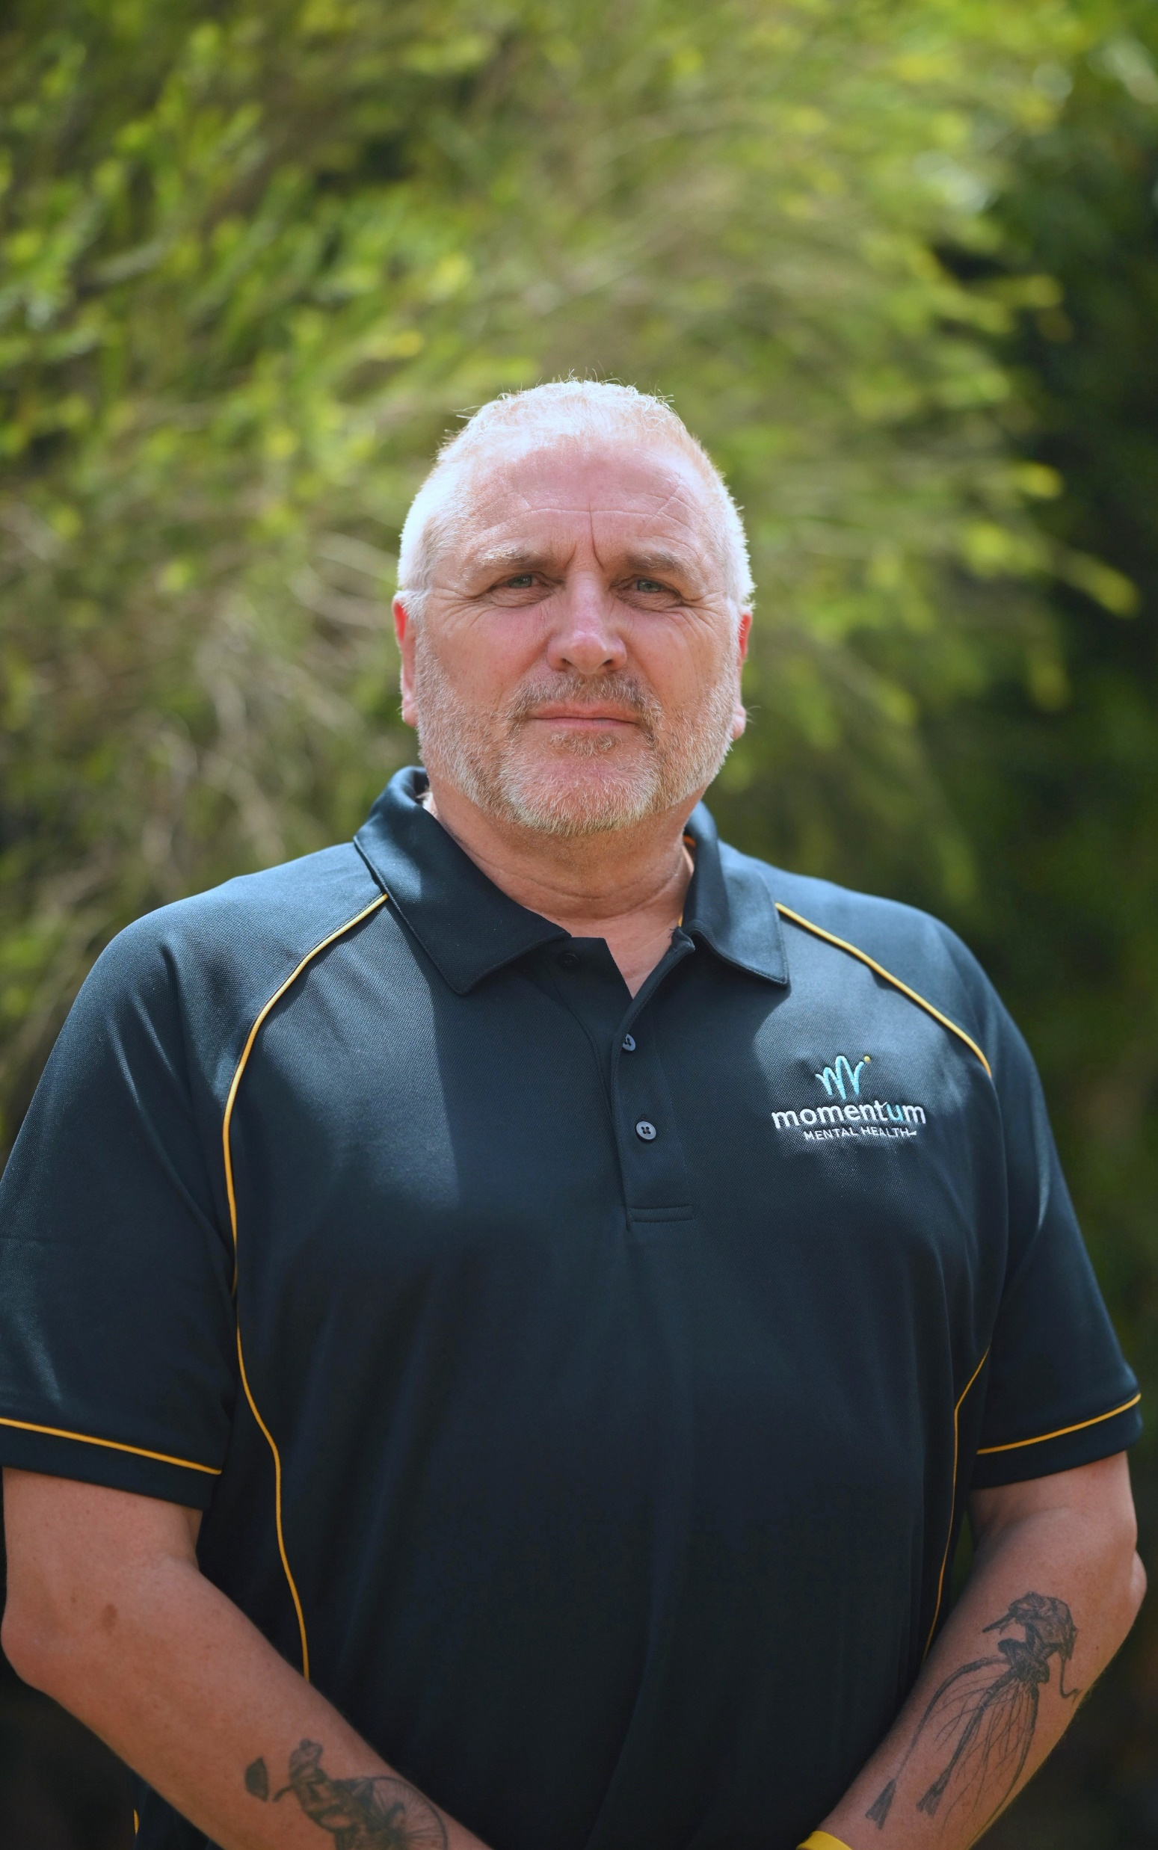
WELLBEING
SYMPOSIUM
PROGRAM
5 Ways to Wellbeing Speed Sessions (8 min each)
Time | Topic | Facilitator 1 | Facilitator 2
12pm | Connect | Dr Clive Williams | Charlie Rowe
 | Being Active | Prof. Tracy Kolbe-Alexander | Ashi, Momentum
 | Keep Learning | Cheryl Kerlin, Momentum | Dr Geoff Woolcock
 | Being Aware | Dr Uma Kumar | Tony Rehn, Connector
 | Help Others | John Lehane, Rotary North | Brian Bracher Momentum
12:45pm | Lunch | Visit stalls and tables 1:10pm optional Tai Chi session, Ashi, Momentum or Meditation session, Heartfulness

Slide 9
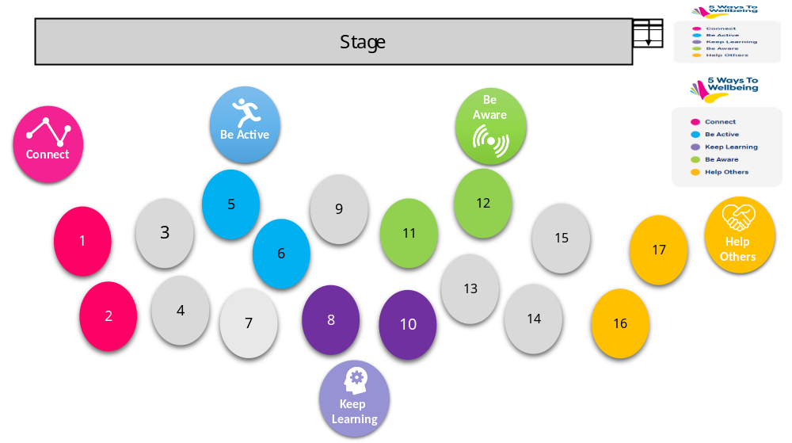

WELLBEING
SYMPOSIUM
PROGRAM
5 Ways to Wellbeing Speed Sessions
Five (5) rounds of 8 mins
The facilitators will change over after 8 mins
Groups will then hear the next 5 Ways to Wellbeing topic:
At Momentum, we use an internationally researched practice framework based on the health literacy improvement program, the “ 5 Ways to Wellbeing”. This focuses on five types of behaviours or everyday things which people can do to increase their mental health and wellbeing. These evidence-based actions have been proven to help people to stay emotionally, socially, spiritually and psychologically healthy, which in turn allows us to build resilience for the hard times.
Connect: Connect with people around you; with family, friends, neighbours or people you meet, at work, school or at the shops. Think of these social connections as important in your life and spend time developing them. Building these relationships will support and strengthen you every day.
Be Active: Keep your mind and body active. Step outside your house or go for a walk or run. Play a sport, dance, ride a bike or do some gardening. Find something you enjoy and do it regularly. Exercising makes you feel good and helps to clear your mind.
Keep Learning: Try something new or rediscover a past interest. Learn to sew, read a new book, listen to a radio program or take on a new role at work. Learn to play a musical instrument or do a computer course. Learning can be fun. It can give you a sense of achievement and build your confidence.
Be Aware: Be aware of the world around you; notice the changing seasons and the beautiful sights, smells and sounds as you do your daily activities. Notice how you feel. Try this as you walk, eat lunch or wait for a bus. Being aware of the ‘here and now’ can help you feel calm and reduce stress.
Help Others: Do something kind for a friend or stranger. Thank someone, smile or say hello. Give your time to a community group or help a neighbour. Helping others can give you a sense of purpose and belonging, build friendships and make your community a better place.
Round 1 Starts with… | Then…Round 2 | Then…Round 3 | Then…Round 4 | Then…Round 5
Connect | Being Active | Keep Learning | Be Aware | Giving Back
Being Active | Keep Learning | Be Aware | Giving Back | Connect
Keep Learning | Be Aware | Giving Back | Connect | Being Active
Be Aware | Giving Back | Connect | Being Active | Keep Learning
Giving Back | Connect | Being Active | Keep Learning | Be Aware

Slide 10
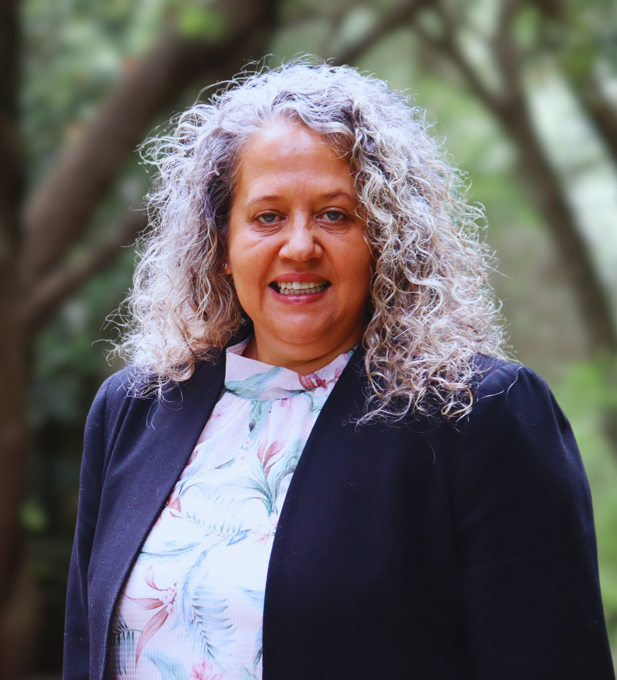
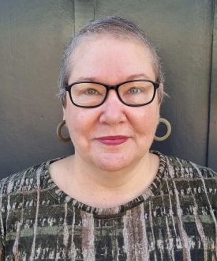
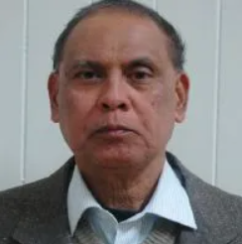
WELLBEING
SYMPOSIUM
PROGRAM
Afternoon Session
Time | Topic |  | Presenter
1:30pm | Strong Fathers Program |  | Charlie Rowe Carbal Medical Services
1:50pm | Wellbeing for men |  | Dr Clive Williams Clinical Psychologist
2:10pm | Wellbeing & Democracy |  | Dr Geoff Woolcock UniSQ
2:30pm | Wellbeing research |  | Dr Raelene Ward UniSQ/Goolburri
2:50pm | Wellbeing for older adults |  | Nikki Combes ADA Link
3:10pm | Q & A session | All speakers
3:30pm | CLOSING |  | Haniff Abdul Razak Pureland Learning

Slide 11
WELLBEING
SYMPOSIUM
SPEAKERS
Adam and Susy Wenitong are the passionate founders of Adapt Mentorship & Consultancy, an organisation dedicated to empowering communities through culturally appropriate solutions. Originally established in 2014 as Young Bruthas to support at-risk youth, their initiative has since expanded, making a lasting impact across Queensland.
With a combined 50 years of experience, Adam and Susy are committed to fostering safer communities through mentorship, advocacy, and collaboration. Adapt Mentorship maintains strong partnerships with key stakeholders, including Youth Justice, Child Safety, Queensland Police Service (QPS), Traditional Owners, Youth Murri Court, and various community organisations and schools. Their programs support 20–30 at-risk youth each week, delivering measurable outcomes in reducing reoffending, promoting positive social choices, and strengthening cultural and community connections.
Their extensive experience includes leadership roles in historic youth crime prevention programs such as YACCA (Youth and Community Combined Action) and YARI (Youth At Risk Initiative). Through dedicated partnerships and collaborations, Adapt Mentorship has become a trusted referral point for government agencies and community organisations, currently working with up to 15 organisations weekly, including Youth Justice, YJCRT, QPS, Murri Court, CatholicCare, Inclusive Counselling, Youturn, Goolburri, Carbal Indigenous Health, and Life Without Barriers YHARS.
Currently, Adapt Mentorship provides support to an average of 25 young people per week who are at risk or involved in the Youth Justice system, with referrals continuing to grow due to the increasing demand for youth crime prevention initiatives. Adam also serves as the preferred cultural advisor for Youth Justice Toowoomba, offering critical insights during employment interviews and policy discussions.
In recognition of their unwavering commitment to their community, Adam and Susy Wenitong were honoured as the 2025 Toowoomba Australia Day Indigenous Citizens of the Year.
Adam and Susy Wenitong

Slide 12
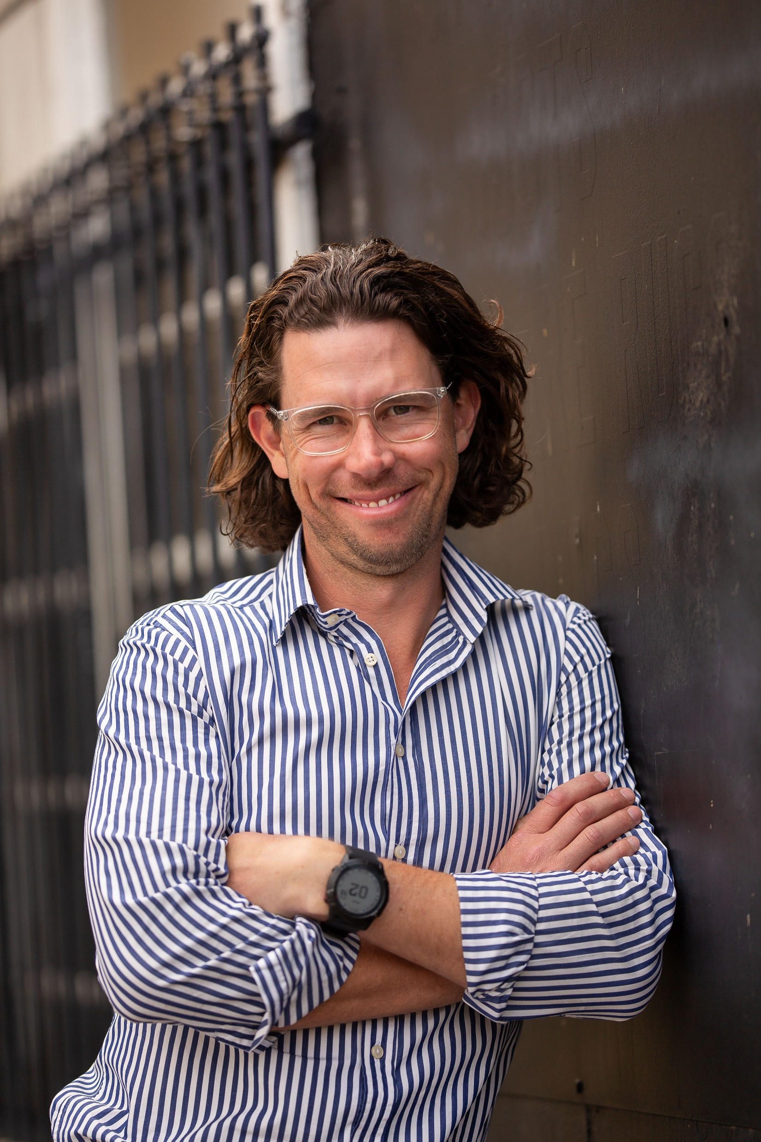
WELLBEING
SYMPOSIUM
SPEAKERS
With over 20 years of experience in community services, Colin Ryan has worked extensively with individuals and families facing challenges related to mental health, homelessness, addiction, and domestic violence. His career spans casework, pastoral care, community development, and youth mentoring, including roles with nationally recognised organisations. Currently, as an Enhanced Outreach Worker for St Vincent de Paul, he specialises in drug and alcohol intervention, while also engaging in volunteer and paid roles that strengthen community support networks.
A long-term Toowoomba resident, Colin has led programs that empower vulnerable individuals, including mentoring young men through the Top Blokes Foundation and facilitating recovery initiatives such as the Life Recovery Program. He has built strong partnerships across service sectors, advocating for holistic, client-centered support. His deep understanding of the complexities of homelessness and addiction drives his commitment to improving service accessibility and community wellbeing.
Col Ryan
Chris Black is the Board Chair of Momentum Mental Health. He holds a double Bachelors’ Degree in Business and Commerce, as well as a Graduate of the AICD. He represents other boards and was the former Vice President of the Toowoomba Chamber of Commerce. He started and then sold a financial services business to a Fortune 500 American Company in 2019 and was noted as one of the most influential advisers in Australia, according to the Financial Standard.
In his spare time, Chris enjoys giving back to the community and keeping fit doing triathlons, park-runs and riding his bike. He also loves cricket, football and racing cars with his brother. He is a father to 3 boys, married to a clinical psychologist and is passionate about changing the conversation with, and removing any stigma around mental health. He believes in proactive mental fitness and believes in a ‘whole of community responsibility’ approach to helping people.
Chris Black

Slide 13
My name is Terri Bromley and I have worked in the Family Support Program for Drug ARM for the last 4 years. Working with families is a privilege and although there are challenging times, overall it is very rewarding when I am able to see connections and bonds growing stronger and families uniting.
Prior to this role, I have had a varied and diverse professional background, working in the DFV space, (this remains something I am very passionate about), nursing as a general practice nurse and within Aboriginal and Torres Strait Islander medical care, a Personal Trainer running my own business and what seems like a lifetime ago, I worked in the corporate private sector as a human resources manager.
In between all that, I have raised 3 amazing humans and recently become a Grandma too. The majority of my parenting journey has been as a single parent and so I feel, my lived and life experiences have provided me with compassion and understanding for the families we support.
I love a new challenge and a bit of adventure and I enjoy running, exercise and down time at home.
Terri Bromley
Uma Kumar has been a Heartfulness Volunteer for 21 years and has been a certified Heartfulness Trainer in the region of Toowoomba for 9 years. Heartfulness has allowed the opportunity for thousands of people to experience meditation and heart based living.
Uma has been a Board Member for Heartfulness Institute Australia and is a Peacefulness Ambassador for the organisation.
In this role she has helped develop programs based around wellbeing and presented at several workshops at multicultural and interfaith workshops.
Uma has been a doctor for 25 years and tries to bring the philosophy of Heartfulness into her work of General Practice.
Her main interest is to integrate physical, mental and spiritual aspects for human wellbeing.
Dr Uma Kumar
Nikki Combes has worked in Disability and Aged Care for 40 years. Nikki works in a project called ADA Link within ADA Australia, assisting older persons who have complex needs to receive support from My Aged Care as well as social and community supports.
Nikki Combes

Slide 14
WELLBEING
SYMPOSIUM
SPEAKERS
Dr Raelene Ward Raelene is a proud Aboriginal woman originating from Cunnamulla. She is a descendant of the Kunja traditional owner group of Cunnamulla and surrounding areas on her grandfather’s side and her grandmother is a descendant of the Kooma people from South-West Queensland. She is a practicing clinical nurse for the last 30 years, focusing clinical work and research on Suicide Prevention, Aboriginal health, Social and Emotional Wellbeing and Mental Health in the broader areas of Social Justice, capacity building and Determinants of Aboriginal health.
Raelene was awarded the Suicide Prevention Australia (SPA) LIFE Award – Indigenous Category, for the unique and creative health program, service partnership encompassing the holistic and social view of health (physical, emotional, cultural and spiritual), wellbeing of Indigenous individuals and communities in promoting suicide prevention across the Darling Downs and South West Queensland. She completed a Masters in Health (research-based) in 2010 titled “In the event of a crisis, what services are accessed and available to an Aboriginal community who have been affected by suicide and/or self-harm” which further warranted the completion of her PhD in 2016 focusing on ‘Suicide Prevention: Exploring Aboriginal understandings of suicide from a Social and Emotional Wellbeing Framework’.
Dr Raelene Ward
Professor Tracy Kolbe-Alexander is currently Associate Head of School (Research), and the program Discipline Lead for Public Health in the School of Health and Medical Sciences at the University of Southern Queensland. She is an honorary Associate Professor at the University of Cape Town (South Africa). Prior to immigrating to Australia (December 2013) she was a Senior Lecturer and Program Lead: Biokinetics (Clinical Exercise Physiology) at the University of Cape Town, South Africa. Tracy is also a World Health Organisation: Physical Activity Expert Consultant.
Tracy’s main research focus is the role of health seeking behaviours on health and well-being in communities, including those with low socio-economic status, regional and remote areas, and the Global South.
Her research expertise is in designing, implementing and evaluating innovative interventions in schools, communities and workplaces.
She has extensive experience in community-based participatory research methods and citizen science programs that aim to address health and equity outcomes.
Professor Tracy Kolbe-Alexander

Slide 15
WELLBEING
SYMPOSIUM
SPEAKERS
Geoff Woolcock is a Senior Research Fellow at the University of Southern Queensland’s Institute for Resilient Regions, and an Adjunct Associate Professor at Griffith University’s Creative Arts Research Institute (CARI), assisting with the evaluation of Brydie Leigh-Bartlett’s Future Fellowship. His doctoral thesis on the HIV/AIDS activist movement whetted his appetite for meaningful, applied community-based research. His long-standing work with the public, private and not-for-profit sectors concentrates on developing qualitative and quantitative measures of progress and community wellbeing, closely collaborating with local communities in place-based, early intervention/prevention initiatives. Geoff is an experienced social researcher with considerable expertise in social and community service planning and evaluation, including social and ESG impact assessment and project evaluation, social capital, collective impact and community capacity building. He has 35 years community-based research experience nationally and internationally, and has co-published over 175 peer-reviewed papers, book chapters and community reports. He has been an advisor to Communitas Community Development and Social Analysis, spoken at several writers' festivals and written regular opinion pieces.
As a Member of the Australian Institute of Company Directors (MAICD), he is a board director of the Brisbane Housing Company (since 2009), the Australian National Development Index (ANDI) (since 2012, Chair since 2019), Thriving Queensland Kids Partnership (TQKP) (since 2023) and co-established Logan Child-Friendly Community Ltd in 2012 overseeing the high-profile collective impact initiative, Logan Together. Geoff is also a Research Fellow of the Wellbeing Economy Alliance, a member of the Anglicare SQ Research Evaluation and Advocacy Reference Group and the Australian Compassion Council and on the Centre for Just Places Advisory Board. As a founder and co-director of Global Talent Tracker, he has worked closely with the Australian Football League (AFL) for over a decade and is a Visiting Professor at Loughborough University’s Institute for Sports Business. He was the Australian member on the executive committee for the Asia-Pacific Child-Friendly Cities Network (2010-2013) and the inaugural Queensland convenor for the Australian Research Alliance for Children & Youth (ARACY) from 2013-2014.
Geoff is a frequent public speaker and commentator about social and sustainable community development using a whole-of-community approach.
Dr Geoff Woolcock

Slide 16

WELLBEING
SYMPOSIUM
SPEAKERS
Shirley-Anne Gardiner has over 20 years’ experience in strategic planning, quality improvement and operational performance. Shirley-Anne has worked in several senior management positions within primary and secondary health care, including seven years as the Executive Director, Toowoomba Hospital – the largest referral hospital in the Darling Downs, Queensland.
Shirley-Anne graduated from Massey University, Palmerston North, New Zealand with a Bachelor of Business Studies (Finance), Bachelor of Arts (Honours) (Social Anthropology) and a Master of Management (Health Services). She is also a graduate of the Australian Institute of Company Directors.
She is an Adjunct Associate Professor with both the Rural Clinical School, Faculty of Medicine, University of Queensland (UQ) as well as with the School of Health and Medical Sciences, University of Southern Queensland (UniSQ).
Shirley-Anne has a passion for the social determinants of health. She is on the Board of two local not-for-profits. In January 2021, she was awarded the Australia Day Citizen of the Year Award in Toowoomba for her work with vulnerable communities.
Shirley-Anne Gardiner
Charlie Rowe is a proud First Nations man who has grown up in the traditional lands of the Jarowair, Giabal and the language group of the western Wakka Wakka (Toowoomba). Charlie is a proud Kamilaroi descendent from his grandfather’s land Toomelah, a little mission in northern New South Wales.
He is a qualified Aboriginal Health Worker (AHW) and the General Manager – Outreach Health Support Services of Carbal Aboriginal and Torres Strait Islander Health Service.
Charlie has a strong community presence within mob and his professional peers and is a leader in his fields when it comes to identifying social issues. He provides high-level guidance and advice to finding grass roots sustainable and impactful solutions.
He developed the Strong Fathers Strong Families program which has earned accolades as being an Australian Benchmark and nationally recognised for the significant differences it makes in men’s lives with their families and improving the mental wellness.
His passion is to give back to his community and share the knowledge and experiences he has gained through his professional and personal journey.
Charlie Rowe

Slide 17

WELLBEING
SYMPOSIUM
SPEAKERS
Dr Clive Williams is a psychologist with 40 years experience in clinical, hospital and organisational settings involving individuals, couples, families and organisations. Key to his work is a fundamental belief that life is change and in this respect, most of his career has focused on identifying the key aspects of any change process, that is, helping people navigate the change whilst problem solving. Further, his model of change includes both the external real-world skills required and the internal psychological skills needed to manage the inevitable anxiety associated with any change.
He is author of the book “A Mudmap for Living” which outlines this process of navigating change whilst problem solving and he has numerous articles published on this change process in various psychological journals as well as making presentations both nationally and internationally. More recently as a Director of Blokepedia his focus has included the area of men’s mental health in both personal and organisational settings, identifying barriers to helping men change and adapt in these areas. Clive’s private practice is in Toowoomba however he works with clients and organisations nationally and internationally.
When not changing the world one person at a time Clive is busy singing to his horses that he and his husband breed on the Darling Downs. Clive is third generation racing family so horses are part of his DNA though he has no clue about how to bet. He also secretly harbours the belief that he could have won X Factor many times over if only he had applied.
Dr Clive Williams
Mandy Young has worked at Lifeline Darling Downs for almost a year, coming from a background of 20 years in hospitality. Her role is to raise awareness within a community and reach as many people as possible. My goal is to make some positive changes & see them implemented.
Mandy Young
Raelene Martin (no photo provided). Raelene works at Good Shepherd

Slide 18
John Lehane spent his early days on a family property outside Quilpie in SW Qld, where John developed a passion for the landscapes of the Australian outback. His family then moved to a property outside Beaudesert south of Brisbane. He completed his primary education in Beaudesert.
John’s secondary education was by boarding school in Brisbane where rugby and cricket distracted him from his studies, more often than desirable.
After secondary school he joined the Qld Dept of Primary Industries as a cadet in the Agriculture Research Group, where he rose through the ranks to ultimately become a Senior Experimentalist and a Workplace Health and Safety Officer, working mainly in southern Qld.
He had responsibility for the management of farming systems/ rotations and plant breeding trials. Recording the agronomic responses of various crops and pastures, and the impact on the chemical and structural component of soils and plant pathology related diseases.
After a very satisfying and enjoyable career of 47 years John retired in 2021.
John’s volunteering experiences have included sporting club committee boards, a State Emergency Service member, and a member of primary and secondary schools sports and grounds committees and managerial roles of club sporting teams when his 2 boys were playing.
John joined Toowoomba North Rotary Club in 2018 where there are many and varied opportunities to help in the community. Back on the board of his club, John is also the incoming President.
He is also a stage 3 bowel cancer survivor from 2006, and as a member of the Qld Rotary Bowelscan team, promotes bowel cancer awareness particularly in the under 50 demographic where bowel cancer cases are increasing.
John is a proud father of 2 fine young men and a grandfather to 2 beautiful young girls. He has many varied interests usually relating to the outdoors, and over the years has travelled widely in Australia and overseas. More travelling, hopefully in the future.
John Lehane
Ashi is a wellbeing coach at Momentum Mental Health. She was born in Tibet and left her country as a refugee. She was raised in India and completed high school there.
Ashi loves to dance and enjoys having fun and being silly every chance she gets.
Ashi has a Bachelor of Arts in English and a Cert III Community Development and Community Work​.
Ashi

Slide 19
WELLBEING
SYMPOSIUM
Facilitators
Cheryl Kerlin is a Wellbeing Coach at Momentum Mental Health. Cheryl is originally from the Blue Mountains N.S.W. and has lived in the Toowoomba area for 30 years. She has two adult sons and three grandsons.
Cheryl graduated from the University of Southern Queensland with a Diploma of Human Services with a Counselling major. She has many years of experience in the community services sector and is driven by her desire to make a difference for all people. She finds it rewarding to help people with mental health issues to have a sense of hope for the future by focusing on their strengths.
Cheryl has a passion for neuro-diverse people as she has many family members who have a diagnosis on the Autistic Spectrum. She has spent most of her time in Toowoomba advocating for and supporting neuro-diverse people and their carers in a variety of settings, including facilitating support groups in schools and peer support programs in community service organisations. She has always used her lived experience to improve the lives of neuro-diverse people and finds it important to treat everyone as an individual with the right to choose their own pathway to wellness.
Cheryl Kerlin
Brian Bracher is a dedicated Wellbeing Coach at Momentum Mental Health, bringing a wealth of experience from law enforcement, corrections, and mental health support. With a career spanning over three decades, Brian has a strong background in frontline services, leadership, and trauma-informed care.
Before joining Momentum, Brian served as a Custodial Corrections Officer and Supervisor with Queensland Correctional Services from 2014 to 2023, ensuring the safety and rehabilitation of individuals in custodial settings. Prior to that, he spent over a decade with Hampshire Constabulary in England (1989–2000), working as a Police Constable and Acting Sergeant.
Brian holds multiple qualifications in mental health, trauma response, and criminal justice.
Passionate about supporting others, Brian is committed to creating a positive and impactful experience for those he works with. His ability to remain calm under pressure, adapt to new challenges, and foster resilience makes him a valuable asset to the Momentum Mental Health team and the wider community.
Brian Bracher

Slide 20
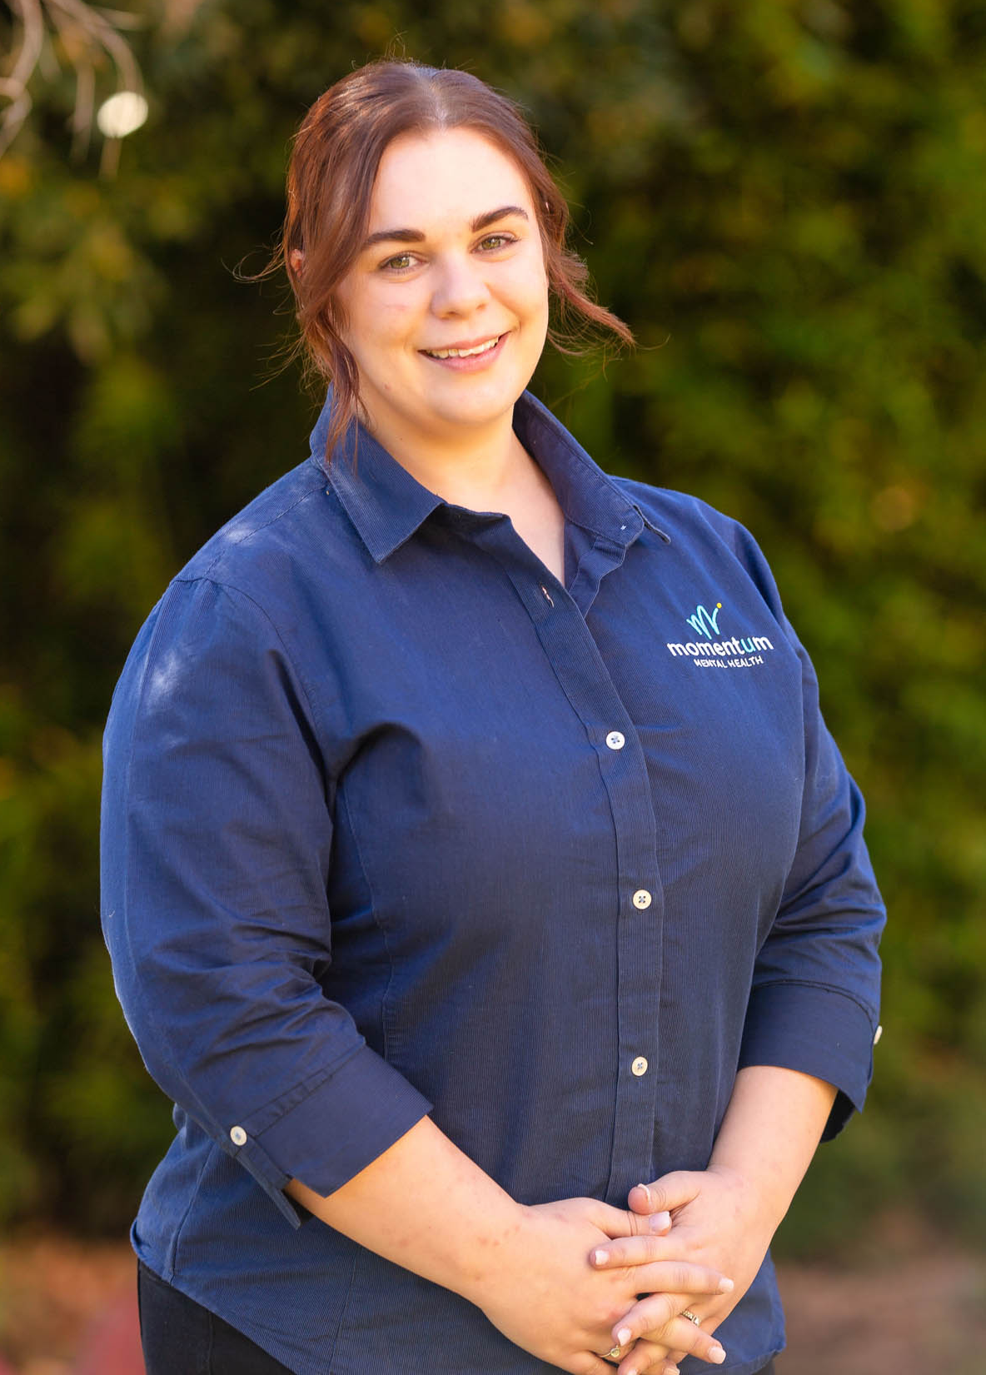
WELLBEING
SYMPOSIUM
Facilitators
Tony Rehn was born in a galaxy far far away….with super powers, flash suit – underpants on the outside, great guy – usual stuff…..
Tony started life in a beachside country town in South Australia. His family moved when he was in high school to just outside Adelaide and later Tony began his working career in a factory in southern Adelaide which produced lenses for glasses.
Seeing no future in this (pun intended) he moved on by joining the SA Police in 1985 and spent his career in Port Adelaide. Roles in general duties and Aboriginal liaison being quite rewarding, however a change in family circumstances instigated a change in geography and Tony joined the Queensland Police in 1997.
Tony Rehn
Starting at Southport in general duties he morphed into a community role working with the Volunteers in Policing and other staff to bring policing to the people. 2006 saw another change and Tony migrated west to Toowoomba, taking up a similar community role, serving the Southern Police Region.
In 2007 Toowoomba Says No to Violence (TSN2V) was born and Tony was involved in that group raising awareness of violence prevention with a focus on violence within a domestic context.
In 2013 a policing restructure saw the regional policing role dissolve and Tony working more directly in the Darling Downs community, again with volunteers, paid staff, multicultural and First Nations people and an interest in violence prevention.
In about 2014, under the tutelage of the new chair John Minz, TSN2V morphed into Toowoomba Together Inc, giving a more positive focus on healthy relationships, gender equality and respect, with a structure designed to move awareness into action. When John stepped back as Chair in 2023, Tony took up the role and is excited to lead a volunteer ‘Band of Brothers and Sisters’ working on eliminating violence in our community.
Tony is fortunate to be married to the ‘long suffering’ Sheriden, a stepdad to 3 amazing boys and their partners, grandpa to a beautiful granddaughter in Melbourne and working on being the ‘Bad Grandpa’ disruptive influence on a 9-month-old amazing grandson……
Ellen Baldwin is the Service and Communications Manager at Momentum Mental Health, bringing a strong background in community services and a passion for making a positive impact. Born and raised in North Queensland, Ellen discovered her calling in community work when she took on an administration role in a local community centre. This experience ignited her commitment to supporting others and fostering meaningful connections.
With a Bachelor of Business Studies, Ellen combines her expertise in business with her dedication to community wellbeing, ensuring effective service delivery and clear communication at Momentum. Outside of work, she enjoys unwinding with a good book or experimenting with new recipes in the kitchen.
Ellen Baldwin

Slide 21
WELLBEING
SYMPOSIUM
SPONSORS
Raffle and Lucky Door Prize Sponsors
Thanks to Our Speaker and Gift Bag Sponsors

Slide 22

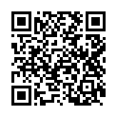
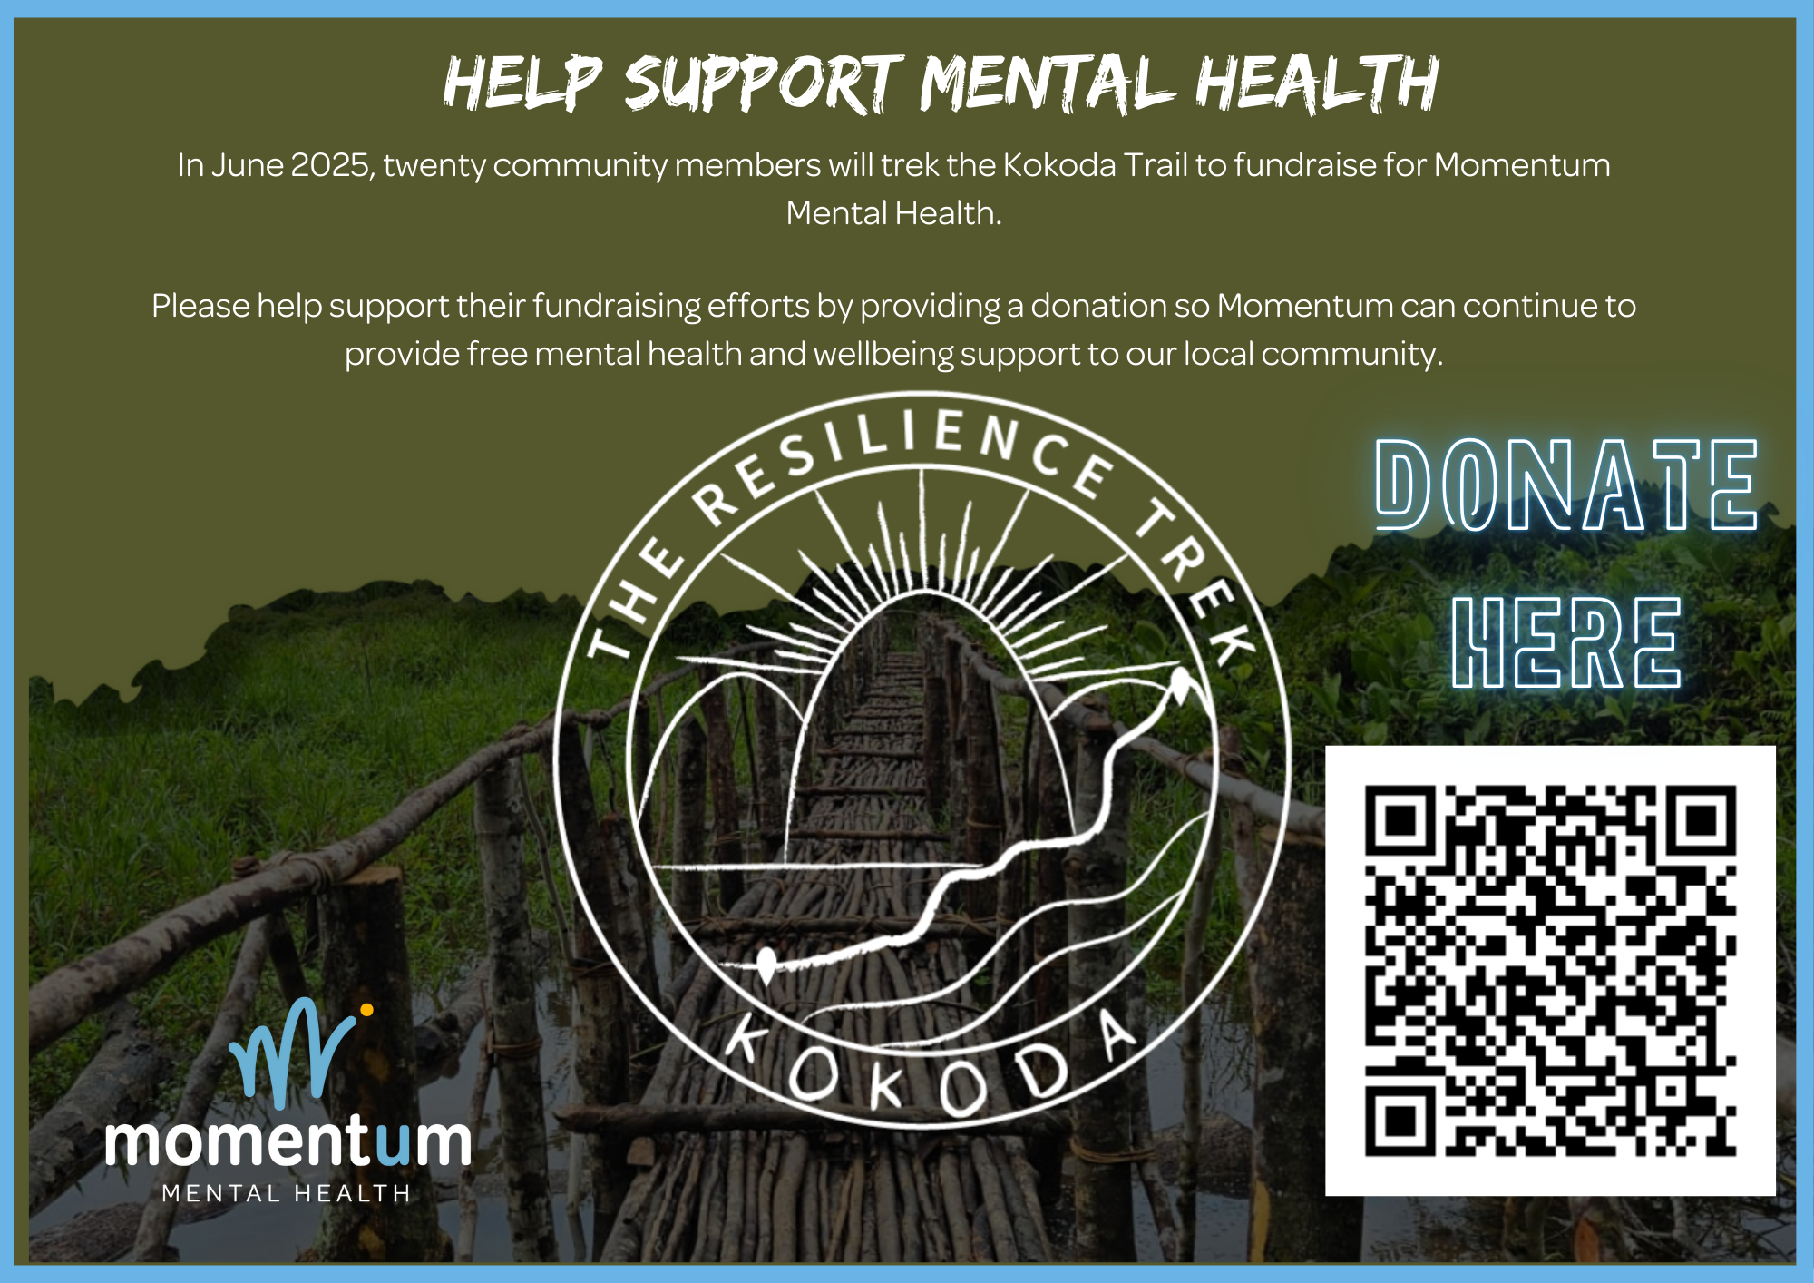
Momentum Mental Health
Momentum Mental Health is a not-for-profit organisation dedicated to transforming mental health and wellbeing in the community. We believe that everyone deserves access to support, every day, regardless of where they are on their mental health journey. Our innovative, prevention-focused approach provides free, non-clinical 1:1 and group coaching to support individuals across the mental health continuum—from severe and persistent challenges to general wellbeing.
With locations in Toowoomba, Warwick, Chinchilla, Dalby, and Kingaroy, we ensure regional communities have access to high-quality mental health support. Through our partnership with Mindware Psychology, we also provide free clinical psychological therapy sessions, making professional care more accessible.
Beyond direct services, Momentum fosters community connections and resilience, partnering with over 60 organisations to create inclusive, supportive environments. Whether through wellbeing coaching, creative workshops, or outreach programs, Momentum is committed to helping people thrive.
For more information, visit www.momentummentalhealth.com.au or connect with us today!

Slide 23
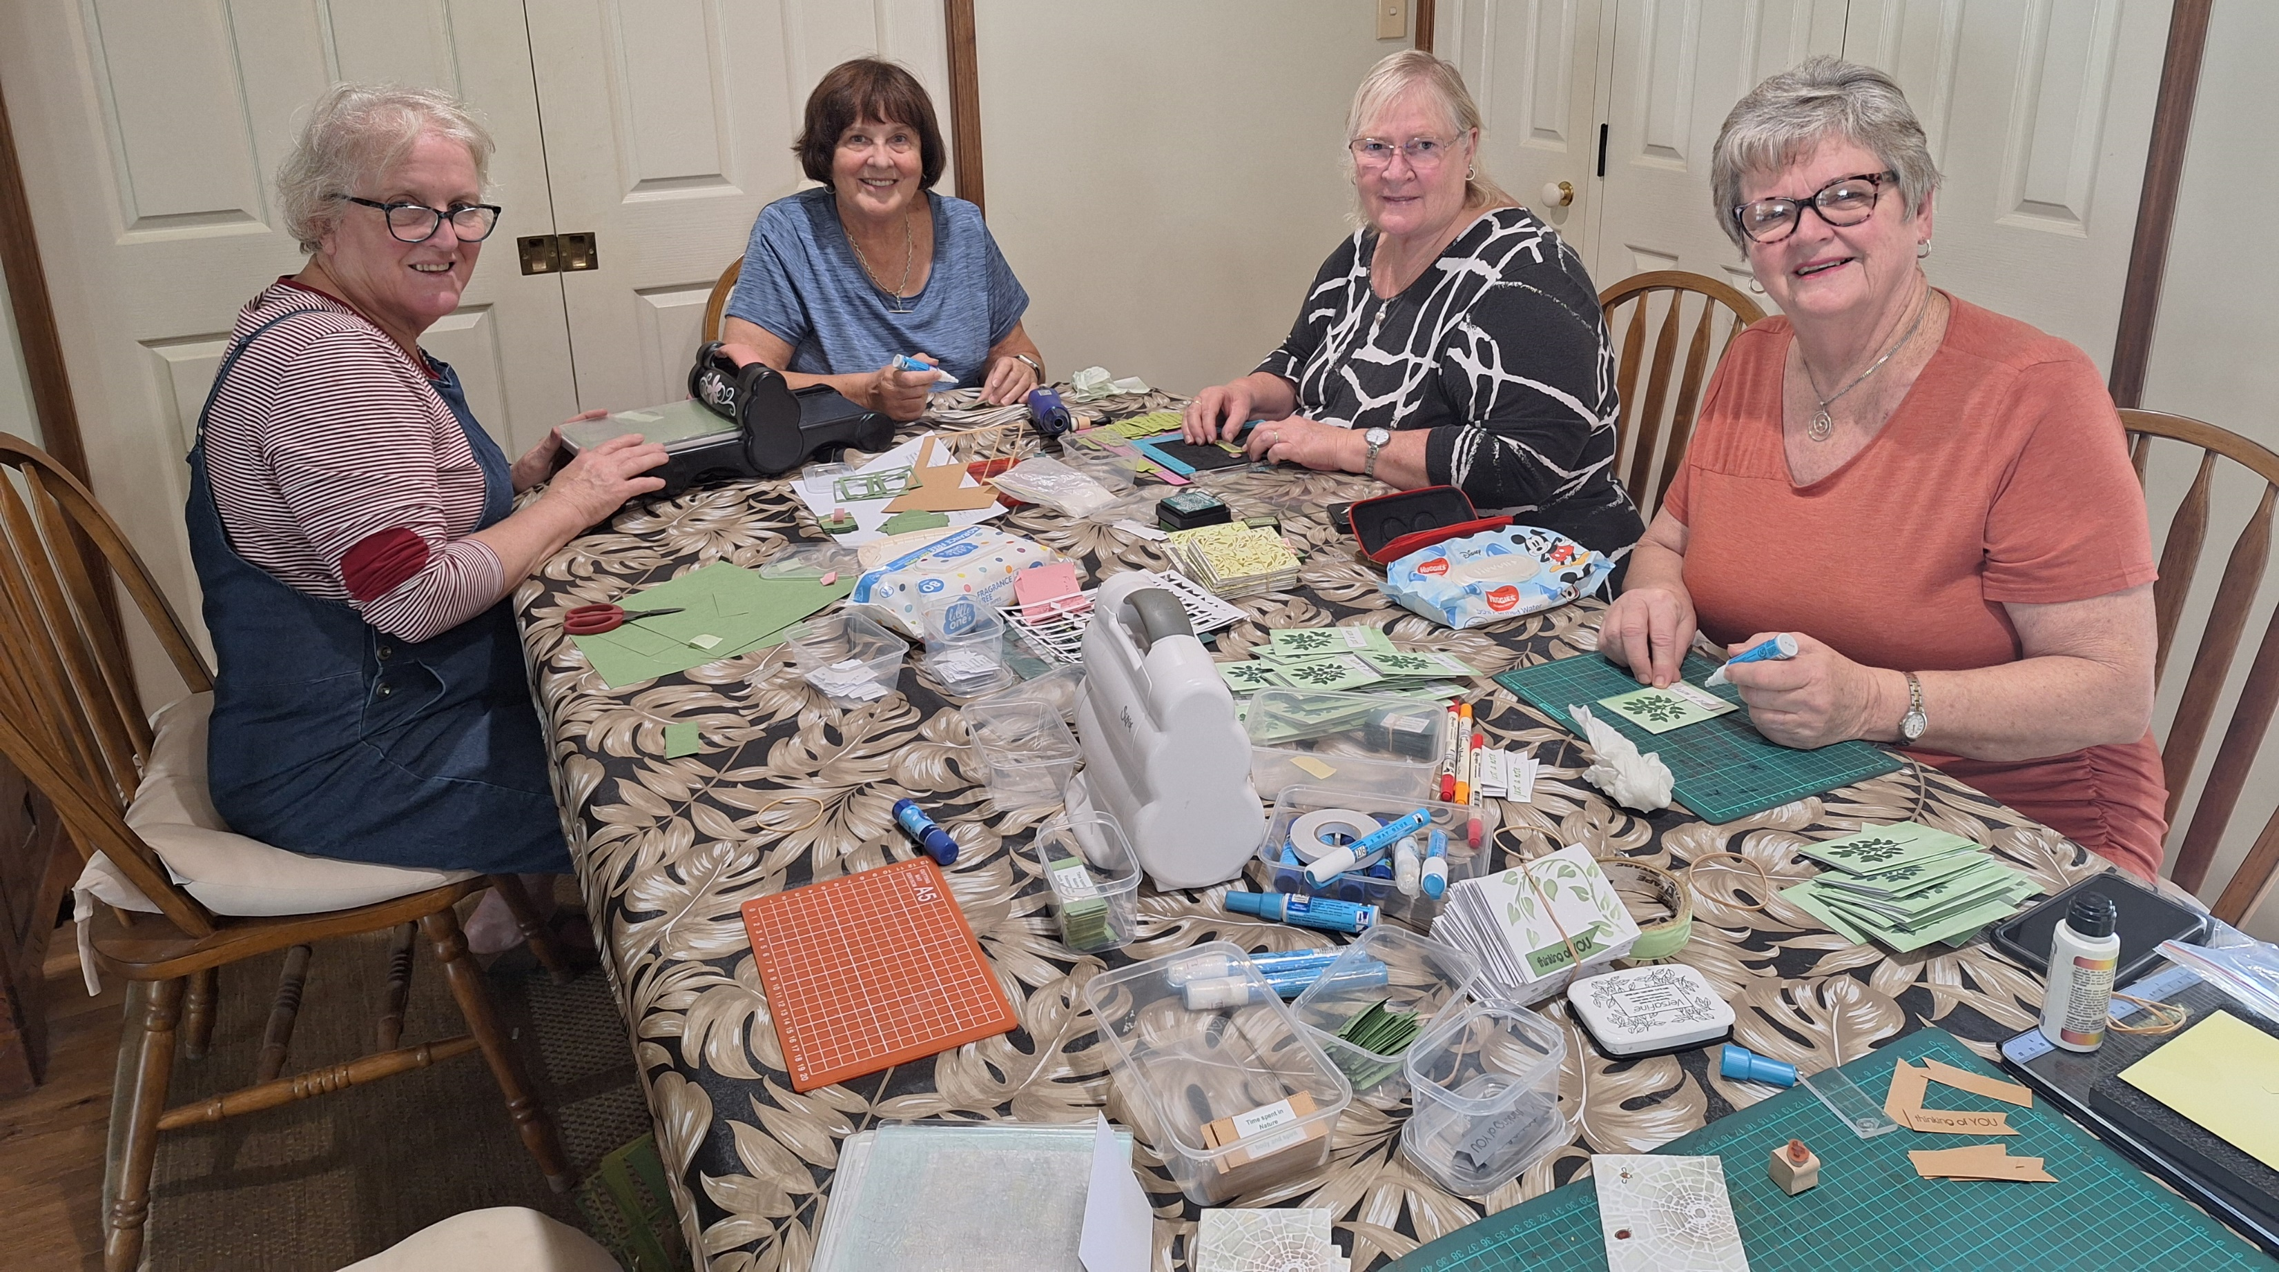
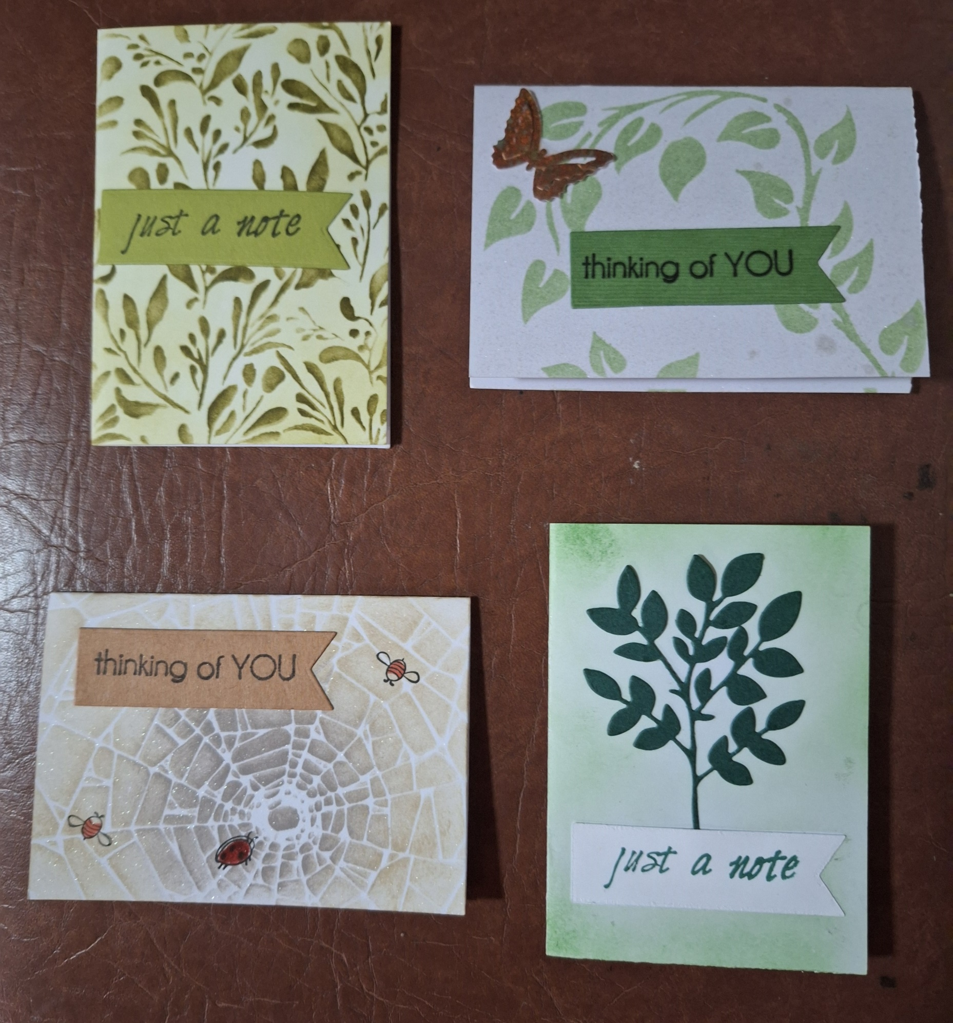
Hike to Heal : Walking Towards Hope, Healing, and Connection
Hike to Heal Australia is a not-for-profit suicide prevention organisation that inspires communities to strengthen wellbeing while walking beside people experiencing mental ill health and suicide loss. Through meaningful connection and shared experiences in nature, Hike to Heal Australia provides a path toward hope, healing, and community support. Hike to Heal Australia was founded out of a deeply personal tragedy. On November 2nd, 2016, the Barton family lost their beloved son, brother, and friend, Nick Pope, to suicide.
A Special Tribute: Handmade Cards for Connection
Tribute to Helen Coman (1950 – 2021)
Written by Caryn Powell
As a founding member of Hike to Heal Australia, I was asked to contribute to the Well-Being Symposium. After consultation with our team, I approached our card group, Denise Jenkins, and Jo Smith to make the cards which will be placed in the conference pack. These cards can be given to those going through a tough time, to let them know that they are not alone and that the giver cares and is thinking of them. Thanks to the volunteers who have stepped us to help make these cards. To make these cards, we are using resources left to our group when our friend and group member, Helen Coman passed away in December of 2021. She endured a long and difficult battle with rheumatoid arthritis. We miss her and always acknowledge her when we use her resources, to make cards.
Helen was a friend who gave a lot of her life caring for others. Initially it was helping her dad with her baby sister, Mary, when her mum passed away. As a teacher, Helen gave of her time to coach netball, going on to coach a state team. She taught in a variety of schools and was an Advisory Teacher to mentor teachers in the curriculum, before finally becoming a Deputy Principal.
Unfortunately, due to poor health Helen was forced to retire and returned to Toowoomba to live close to her family. This is where we met Helen when she joined our ladies card group at the home of Jo Smith. While Helen didn’t think she would enjoy making cards, it ended up being a passion for her which gave her much pleasure. We met Mary, her sister, who also tragically died of cancer, leaving Becca (Rebecca) her niece, to whom Helen was devoted. It was after this that we met her Dad, Maurie when he moved in with Helen due to poor health, Maurie passed in 2014. Helen was very close to Chris, her other sister who helped Helen to endure the many painful setbacks resulting from her rheumatoid arthritis. Helen was a strong advocate for family and was always there to help in times of hardship.
Left to Right: Meg Englart, Jo Smith, Denise Jenkins, Fleur Winter (striped shirt), Caryn Powell (orange shirt).

Slide 24
WELLBEING
SYMPOSIUM
STALLS
By Organisation (A – Z)
Organisation | Stall Number
ADA Link | 12
At Ease Yoga Somatics | 20
Aurora Training | 29 (Shared)
Avive | 4 (Shared)
Breakaway | 23
Carbal Medical | 28
Catholic Care | 8
The CHANGE Project, TRC | 14
Civic Assist | 30
Community Access Care | 15
Cooby Reflections | 2 (Shared)
Darling Down African Communities Council | 26 (Shared)
Drug Arm | 3
Focused on Care | 25
Footprints Community | 27
Goolburri | 31
Headspace | 9
Heartfulness Meditation | 11
Hike to Heal | 24
Hope Horizons | 22
Jayden Adams Memorial Foundation | 13
Lifeline Darling Downs | 18
Life Without Barriers | 19
The Lighthouse | 7 (Shared)
Lives Lived Well | 10
Momentum Mental Health (General) | 5
Momentum Mental Health (Kokoda) | Entrance
Mercy | 26 (Shared)
Mindware Psychology | 2 (Shared)
One Bridge | 16 (Shared)
PFLAG+ | 21
Pureland Learning | 7 (Shared)
Richmond Fellowship Queensland (RFQ) | 29 (Shared)
Rotary (East Wilsonton) | 16 (Shared)
Rotary Toowoomba (North) | 4 (Shared)
TASC | 6
Wilsonton Heights Community centre | 17
Yellowbridge | 1

Slide 25
WELLBEING
SYMPOSIUM
STALLS
By Stall Number
Organisation | Stall Number
Momentum Mental Health (Kokoda) | Entrance
Yellowbridge | 1
Cooby Reflections | 2 (Shared)
Mindware Psychology | 2 (Shared)
Drug Arm | 3
Avive | 4 (Shared)
Rotary Toowoomba (North) | 4 (Shared)
Momentum Mental Health (General) | 5
TASC | 6
The Lighthouse | 7 (Shared)
Pureland Learning | 7 (Shared)
Catholic Care | 8
Headspace | 9
Lives Lived Well | 10
Heartfulness Meditation | 11
ADA Link | 12
Jayden Adams Memorial Foundation | 13
The CHANGE Project, TRC | 14
Community Access Care | 15
One Bridge | 16 (Shared)
Rotary (East Wilsonton) | 16 (Shared)
Wilsonton Heights Community centre | 17
Lifeline Darling Downs | 18
Life Without Barriers | 19
At Ease Yoga Somatics | 20
PFLAG+ | 21
Hope Horizons | 22
Breakaway | 23
Hike to Heal | 24
Focused on Care | 25
Darling Down African Communities Council | 26 (Shared)
Mercy | 26 (Shared)
Footprints Community | 27
Carbal Medical | 28
Richmond Fellowship Queensland (RFQ) | 29 (Shared)
Aurora Training | 29 (Shared)
Civic Assist | 30
Goolburri | 31

Slide 26



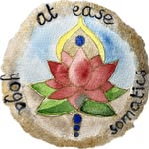

WELLBEING
SYMPOSIUM
STALLS
ADA Link
Aged and Disability Advocacy Australia (ADA Australia) is a not-for-profit, independent, community-based advocacy and education service with 30+ years’ experience in supporting and improving the wellbeing of older people and people with disability. Our services are free, confidential and client focused.
ADA Link is a care finder service, funded by Darling Downs & West Moreton PHN, who provide individual support to vulnerable seniors to access aged care and other services in the community.
ADA Link provides free, independent information about support options, interacting with My Aged Care and health professionals, providing guidance to understand service agreements, solving other challenges and connecting with community-based supports.
Adapt Mentorship
Adapt Mentorship & Consultancy is an Indigenous-led social enterprise founded by Adam Wenitong (Gubbi Gubbi). Adapt is committed to driving community-led solutions that address youth crime, social and emotional well-being, and cultural empowerment. At the heart of Adapt’s work is a deep engagement with young people, families, and the wider community. Through innovative programs that strengthen cultural identity, foster personal growth, and create pathways to positive choices, Adapt has built a strong track record of reducing youth offending and improving outcomes for First Nations youth. By working in partnership with various organisations and community leaders, Adapt has delivered measurable success—bridging gaps in support, fostering long-term change, and ensuring young people have access to the mentorship and guidance they need to thrive.
Welcome to At Ease Yoga Somatics! I’m Sylvie Hockin, passionate about health, wellbeing and neurodiversity. This is the name I chose to bring out practices that have transformed me on my path to wellness. Graduated from the renowned Yoga North International SomaYoga Institute in Minnesota, U.S.A., my offerings combine adaptive forms of Yoga asanas, somatic movements and breathwork. As well as working well on posture improvements, the classes encourage tuning in to what our mind and body need, empowering us over our health as a result. Today, these practices are part of my wellbeing toolkit and I am pleased to share them with the public in my classes.For more info., contact me on 0409 037 335 or email at.ease.yoga.somatics@gmail.com
https://www.facebook.com/AtEaseSomaticYoga
https://www.instagram.com/at_ease_yoga_somatics/
At Ease Yoga Somatics
Aurora Training Institute
Aurora Training Institute provides exceptional education and training choices, whether you are looking for your first job, returning to the workforce, seeking a career change or even a promotion with your current employer.
We are serious about providing you with world-class education and training at every stage of your personal and professional development.

Slide 27


WELLBEING
SYMPOSIUM
STALLS
Avive
Avive Clinic Brisbane is a new 63-bed private hospital located in Windsor. We also have a hospital in Mornington Peninsula and are currently building our Adelaide and Gold Coast facilities. Designed with patient-centric principles and equipped with the latest technology, the clinic is led by an experienced team of psychiatrists and mental health professionals. We specialise in treating mood disorders, anxiety disorders, substance use disorders, early life trauma, and adult trauma, including support for defence personnel, emergency workers, and first responders. We are a tier 1 Department of Veterans Affairs (DVA) provider. The clinic also provides supervised de-prescribing where necessary. We currently get numerous referrals through from Toowoomba and surrounding areas.
Breakaway
Breakaway Toowoomba began in 1986 when a group of parents united to provide respite services for families of children with a disability. Breakaway expanded to Toowoomba and nearby regions.
The organisation was instrumental in expanding the focus from centre-based group support to an individual community-based approach. Prior to this time respite resources were severely limited and rural families were often disadvantaged by their distance to support. In July 2004, the organisation changed its name from Manuka to Breakaway Toowoomba Inc. or Breakaway as it is known today. Since this time, the organisation has continued to evolve and grow, resulting in more services being made available to a greater number of people with a disability and their families.
Carbal Medical Service
Carbal Medical Services is an Aboriginal Medical Service (AMS) that tailors its clinics and services to meet the needs of the local population in Toowoomba and Warwick. Carbal acknowledges all support provided by the Federal and State government Departments of Health and our many partners. Our service is dedicated to improving the prevention and management of chronic disease through early intervention and improved access to culturally appropriate medical services.
Established in 2002, Carbal originated from the efforts of local Aboriginal residents to establish a culturally-appropriate and safe health service in Toowoomba that could comprehensively address the specific health needs of our people. Carbal Medical Services is an Aboriginal and Torres Strait Islander Community Controlled Health Care Organisation (ACCHO).
Catholic Care
CatholicCare is a social service community organisation dedicated to supporting individuals, couples and families through life’s challenges. Our mission is to provide inclusive, person-centred support through family dispute resolution, counselling, migrant and refugee services, early intervention youth programs and rural and remote support services. We walk alongside people, supporting them as they navigate life’s tests. Everyone is welcome, regardless of background or belief—because no one should have to face life’s challenges alone. We’re with you.

Slide 28


WELLBEING
SYMPOSIUM
STALLS
CHANGE Project
The award-winning Change Project offers Toowoomba Region residents a variety of fun, low-cost activities for all fitness levels and abilities making it easy to get moving, stay active, and feel great. Whether you're a beginner or looking to challenge yourself, the Change Project has something for everyone including yoga, tai chi, meditation, social sports and loads more.
There has never been a better time to get involved, meet new people, and enjoy the journey to better mental, physical and social wellbeing. Become the best version of you with the Change Project today.
Civic Assist
Civic Assist believes that communities are made great by those that work together for everyone’s benefit. They foster community collaboration to create programs that empower individuals for a better future. The team focuses on innovative initiatives, benefiting people of all ages and backgrounds. Key programs include the Civic Assist Support Centre, offering low-cost items through the Op Shop and free practical support through the Assistance Program and initiatives such as the Winter Warmth Appeal. Additionally, the Civic Assist Street Crew provides after-hours safety and support, offering Youth Outreach and Safe Night Precinct Services on Thursday, Friday, and Saturday nights.
Community Access Care
Community Access Care is a family-owned company and registered NDIS support provider, with grassroots values at its core. Founder Julie is joined by her family, who are all a part of CAC.
Good old fashioned family values ensure the team and Participants feel part of the family too.
At Camp Cooby, we create transformative experiences that nurture growth, connection, and wellbeing across all life stages. Our immersive corporate programs develop leadership, resilience, and workplace wellbeing through dynamic team challenges, strategic problem-solving activities, and reflective workshops. Alongside this, our Empowering Horizons Therapeutic Programs provide vital respite care and personal development opportunities in a safe, supportive environment for all ages. Set in stunning natural surroundings, our programs encourage participants to step outside their comfort zones, strengthen communication, and build trust. Whether you're seeking corporate team development or therapeutic support, Camp Cooby's unique blend of outdoor activities, including high ropes courses and fireside connection sessions, provides the perfect environment for growth and transformation. Camp Cooby – Care, Connect, Lead.
Camp Cooby

Slide 29



WELLBEING
SYMPOSIUM
STALLS
Darling Downs African Communities Council
The Darling Downs African Communities Council (DDACC) is a branch of the Queensland African Communities Council (QACC), focusing on empowering and supporting African youth and families in the Darling Downs region, with a mission to promote inclusivity and positive community engagement.
Drug Arm
Drug ARM is a specialist not-for-profit, non-government organisation that supports people, families and communities to achieve positive transformation through rehabilitation and treatment, outreach, family support, awareness and prevention, information and education, advocacy and policy.
Focused on Care
Focused on Care provides personalised, high-quality support for NDIS, NIISQ, and DVA participants across South East and South West Queensland. We offer services in Support Coordination, Supported Independent Living, Home and Community Support, and Community Access. Our client-centred approach tailors care to each individual’s unique needs.
Through a thorough induction, we understand the client’s disability, goals, and preferences, and match them with skilled support workers from our extensive database. This leads to the best outcomes for our clients. Support workers are fully briefed to ensure a smooth, effective partnership. For more information, contact us at 1300 144 422 or info@focusedoncare.com.au.
Raffle and Lucky Door Prize Sponsors

Slide 30



WELLBEING
SYMPOSIUM
STALLS
Footprints Community
Footprints Community strives to create an inclusive community where individuals can maintain an independent lifestyle of their choice. Footprints commenced in 1991. Over thirty years later, we have diversified and grown significantly, with more than 240 dedicated staff and 33 volunteers, supporting approximately 4,451 clients.
Footprints has a long history servicing the community of which you are a part of. Footprints values its relationships with clients, funding bodies and other agencies. We partner with primary health care, health and hospital services, government agencies, other service providers and the private sector to enhance the quality of life of the people we serve.
Goolburri Aboriginal Health Advancement
Goolburri Aboriginal Health Advancement Company Limited is an incorporated Aboriginal Community Controlled Health Service who have supported Aboriginal and Torres Strait Islander and non-Indigenous communities in the Toowoomba, Darling Downs and South West region for over 23 years.
Our not-for-profit organisation provides General Practitioner (GP), Oral, Primary and Allied Health Services, with a range of Home and Community Care, Family Wellbeing, Aged Care Services, Early Numeracy and Literacy Support and NDIS services. We are responsive to the needs and aspirations of Aboriginal and Torres Strait Islander peoples, families and communities within the Goolburri Region and support them to exercise control of their Health and Wellbeing.
Headspace
Headspace Toowoomba offers Care and Support for Young People aged 12 to 25.
Family and Friends are also most welcome.
We offer Mental Health, Physical & Sexual Health, Drug & Alcohol, and Work & Study support.
Heartfulness Institute
Heartfulness Institute is a nonprofit organisation, with several million practitioners in 160 countries. Heartfulness relaxation and meditation techniques are studied and proven to be effective in reducing stress and anxiety, improving sleep, enhancing emotional intelligence, and exploring the heights and depths of human consciousness.
Our mission is to help develop peaceful, healthy and holistically educated individuals and children, families and communities, organisations and businesses, and government organisations with a spirit of human well-being and oneness.

Slide 31


WELLBEING
SYMPOSIUM
STALLS
Hike to Heal
Hike to Heal Australia is a not-for-profit suicide prevention charity dedicated to promoting mental health and well-being. Through engagement with the natural world, we inspire individuals to step outdoors and connect with nature's healing power. Beyond our hiking adventures, we raise awareness about suicide prevention and mental health through impactful campaigns, resilience workshops, and community promotions. Together, we aim to foster hope, build strength, and create a supportive community that takes steps—both literal and figurative—toward healing. Join us on the path to wellness and make a difference with Hike to Heal.
Hope Horizons
Hope Horizons Cancer Wellness Centre opened its doors in Toowoomba, Southeast Queensland in 2017. Born from a desire to see free allied health services provided for those living with cancer in the region, while ever cancer remains, our mission is to diminish its impact. Our services are provided with no out-of-pocket expense to our clients, with the gap costs covered wholly by our fundraising efforts. Our beautiful home, the Jenny Black Cancer Wellness Centre has been built through the generosity of the Black family and the entire Toowoomba community. We invite you to visit us and be part of the exciting future of Hope Horizons.
Jaydon Adams Foundation
The Jaydon Adams Foundation (JAF), was formed in honour of Jaydon Adams, a remarkable young man and and ensures that his contributions to Aboriginal health at all levels will live on. Through JAF we hope to enhance and promote First Nations cultural heritage and positive identity. We provide trainings and programs where we see the gap and need for our people.
Mental Health First Aid Trainings
Cultural Safety trainings
Social Emotional Wellbeing program (SEWB)
Bringing back Dignity program (The 5 R’s)
Strong Minds, Strong Spirits Program
Sports & Recreation Program
Community & Engagement Program
Come say hi at our stall.
Lifeline Darling Downs and South West Qld
Lifeline is a not-for-profit charity that provides a range of services and supports to individuals and families across the Darling Downs and Western region. We engage and empower individuals to build resilient communities. Our core values are: Connection, Inclusion, Relationships, Social Justice and Compassion. Our programs include: Family Intervention Service, Gambling Help, Crisis Counselling, Positive Relationships Program, Financial Counselling and more. Lifeline aims to provide the best services available to meet the needs of clients and the community. We exist to build strong communities which empower people to live to their full potential.

Slide 32




WELLBEING
SYMPOSIUM
STALLS
Youth Housing and Reintegration Service (YHaRS): At Life Without Barriers, we want to ensure YHaRS play a critical role in helping young individuals find stable housing solutions, whether they are in need of emergency shelter or long-term housing options. Having a dedicated worker assists with practical needs and offer emotional support to greatly enhance the overall well-being of these youths.
Eligibility
• 12-21.
• Homeless or at risk of being homeless.
• Seeking financial support to achieve a goal.
• Transitioning from juvenile detention.
• Transitioning from child safety.
Life Without Barriers
The Lighthouse
The Lighthouse Toowoomba has one audacious goal – every child in Australia reads, writes, and creates with confidence. We are focused on children in the Toowoomba region by providing books for homes, writing workshops, and a vibrant gallery space with inspiring exhibitions.
Lives Lived Well
For over 40 years Lives Lived Well has been supporting people to live their lives well. We are a not-for-profit healthcare provider that offers evidence-based services across Queensland, New South Wales and South Australia. We offer specialised support for; alcohol and other drugs, mental health, gambling and veteran’s wellbeing, with 6 drug and alcohol residential facilities in Queensland and 2 in NSW. Specifically in the Darling Downs we provide alcohol and other drug counselling and mental health support. For further information please see our website https://www.liveslivedwell.org.au/
Mercy
Family and Child Connect is here to offer free, confidential, and unlimited support to families facing challenges. We listen to your needs and connect you with local resources that can help with issues like managing children’s behaviour, building stronger family relationships, addressing domestic violence, managing finances, and more. We provide personalised advice and can offer access to interpreters if needed. Whether through phone consultations or home visits, we are here to support you as often as needed, with no cost involved. No matter the situation, we’re here to help you find the right support for your family. Please call 133264 or visit our website for more information www.familychildconnect.org.au

Slide 33




WELLBEING
SYMPOSIUM
STALLS
Mindware Psychology
Supporting Mental Health & Wellbeing Across the Lifespan.
Celebrating 10 years of service, Mindware Psychology is a locally owned Toowoomba practice committed to providing accessible, evidence-based mental health care for individuals, families, and organisations. With a team of up to 17 psychologists, we have no waitlist for private services. We also collaborate with Momentum and Hope Horizons to offer bulk-billing and student-led free clinical services (with a waitlist). Additionally, we partner with Camp Cooby and Reflections Lake Cooby to deliver group-based therapy programs and corporate retreats, fostering personal growth, resilience, and team development in outdoor settings.
Mindware Psychology – helping you thrive.
One Bridge
OneBridge is a mobile outreach and place-based health service dedicated to supporting individuals within the central area of Toowoomba who are experiencing homelessness or are at risk of homelessness. Our goal is to provide care that addresses both the health and social needs of our clients, ensuring they have access to the resources and support necessary to improve their quality of life. Our team consists of dedicated nurses and social workers.
For more information about our services or to get in touch, please see our website: https://onebridge.com.au/
PFLAG+
PFLAG+ Toowoomba and the Darling Downs is a peer support network with the goal of helping bring about a society in which all people can flourish, regardless of their gender identity, body type or sexual orientation. Our acronym stands for ‘Parents and Friends of LGBTIQA+ people’.
Our aim is to ‘support, educate, advocate’. By sharing information and our experiences we hope to make the path easier for parents and families with loved ones in the LGBTIQA+ community. We meet up with individual families for coffee, organise occasional talks by qualified practitioners in the LGBT+ space and hold a rainbow market stall to help increase visibility for this often vulnerable community.
Reflections Lake Cooby
Discover strategic clarity and team connection at Reflections Lake Cooby, where nature becomes your boardroom. Just 30 minutes from Toowoomba, our premium 50-acre lakeside retreat transforms corporate gatherings into inspiring experiences. Here, strategic planning aligns with sunrise reflections, leadership development unfolds on nature walks, and team bonds strengthen through tailored activities. Our expert-led programs blend professional development with wellness elements - from mindfulness sessions and personality profiling to innovative team challenges - all designed to spark creativity and enhance workplace wellbeing. In this tranquil bushland setting, your team will find the space to think bigger, connect deeper, and return to work energised and aligned. Reflections Lake Cooby – Nurture in Nature.

Slide 34
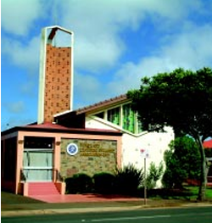

Pureland Learning College
In 2001, the Venerable Master Chin Kung A.M. decided to make this city the home for Pure Land Learning College Association Inc. Since that time, as well as being a Buddhist Centre, it has also become a Peace Advocate Centre that brings everyone together, building a shared future for a better world to live in.
The Pure Land Learning College Association (PLLCA), under the guidance of Venerable Master Chin Kung, AM, has been supporting many multicultural and multifaith activities since 2002. Lasting peace and harmony for all living beings is the hope that we share with everyone who travels on the same ship that we call Earth. With the seemingly endless waves of disasters, man-made and natural in recent years, we feel that it is our responsibility to do our part to help improve our chances of achieving peace and harmony.
The PLLCA Multifaith Multicultural Centre’s objective is to have Toowoomba as a Model City of Peace and Harmony. We wish to preserve and treasure the distinct features of each ethnicity and culture. With a mind that is loving, compassionate, and accepting, we can all mutually respect, accept and harmoniously treat one another impartially.
In pursuit of this vision, the Multi-Faith Multicultural Centre of the Pure Land Learning College Association was established to promote Peace, Harmony and Social Cohesion in Toowoomba. Making Toowoomba a Model City of Peace and Harmony will require leadership and guidance from each community leaders to realise peace and harmony. It also has to include every segment of the community to take ownership of this vision. As part of the strategy to achieve peace and harmony, it is important that each member of the community becomes actively involved. The need to understand, accept, and actively support the vision of creating a community of peace and harmony is important. To achieve this goal and to help us chart our journey, we are guided by a strategic road map and yearly action plan developed by the Multi-Faith Multicultural Centre. The strategic road map covers the vision, mission, strategic objectives, and core programs. We place great emphasis on dialogues at all levels, religious education, training, forums, workshops, community integration activities, focus group discussions, and exchange programs.
To achieve that goal, the Multifaith Multicultural Centre's efforts are based on the following:
Vision: Toowoomba - A Model City of Peace and Harmony.
Mission: To strengthen social cohesion, promote greater social trust through greater appreciation of diversity in faiths and beliefs across multicultural communities.
PLLCA and the Multifaith Multicultural Centre, together with strong support from faith and community leaders in Toowoomba, Australia, is offering strategies and a plan of action towards achieving the vision of establishing Toowoomba as a Model City of Peace and Harmony.

Slide 35





WELLBEING
SYMPOSIUM
STALLS
Richmond Fellowship Qld
We support people in recovery. We inspire hope and empower people. We work with our partners to support people’s recovery. Together, we can recover futures. We are part of an international family of Richmond Fellowships, with the foundation programs established in Richmond Surrey England in 1959 by Elly Jansen. With Elly’s support, Brisbane GP Dr Charles Elliott founded Richmond Fellowship Queensland (RFQ), incorporated as a not-for-profit company in 1974. Today, we combine the inspirational vision and values of our founders with progressive thinking, advanced research and evidence-based practice.
Rotary – East Wilsonton Toowoomba
As part of the worldwide Rotary International, the Rotary Club of Toowoomba East RCTE is one of eight Rotary Clubs in Toowoomba. Rotary Club members are volunteers who work locally, regionally and internationally to assist others by using their skills and expertise whilst enhancing their professional networks and career development. Members receive satisfaction in seeing the positive impact of their work and in doing so, develop lifelong friendships, engage in fellowship and have fun. To be able to fund Rotary contributions to the community RCTE conducts its Outback Getaway tag along journey every second year. OBG 25 is being conducted in September 2025 with a portion of the funds raised to be donated to Momentum Mental Health.
Rotary – Toowoomba North
The Rotary Club of Toowoomba North was established in 1971 and for 54 years has focused to provide assistance to those in need. We meet every second Wednesday for dinner from 6.30pm to 8.30pm at the Burke and Wills Hotel and provide fellowship, education and enjoyment for members. Membership is open to anyone with a community spirit, and an interest in helping others to improve their lives. For further information therotaryclub.com.au
The club’s major annual fundraiser is The David Hack Classic. www.facebook.com/davidhackclassic. The Club also fundraises via BBQs and provides labour to other Toowoomba community support organisations. Over the past 25 years we have supported 13 projects with funds raised in our community.
TASC
At TASC, we care about you and your rights. We want to make sure you feel supported and understood. Our team is here to help you with legal issues and to fight for your rights. We believe that everyone deserves fair treatment and equal opportunities.
TASC’s solicitors, social workers, and advocates are here to assist you with common legal problems and issues related to your human rights, such as abuse and discrimination. We want to help you understand what you can do about these problems and support you in taking action. The best part is that our services are completely free for eligible people living in the regions we serve. We offer legal help in areas like family law, domestic and family violence, civil and consumer law, and minor criminal matters. We also provide free advocacy and social justice services.

Slide 36

WELLBEING
SYMPOSIUM
STALLS
Wilsonton Heights Neighbourhood Centre
Wilsonton Heights Neighbourhood Centre – Supporting Communities, 14 Wine Drive, Wilsonton Heights
Ph 4634 7672 E: reception@whnc.com.au
At Wilsonton Heights Neighbourhood Centre we are dedicated to fostering and supporting families and individuals in the community. We offer a range of essential services such as food assistance through collaboration with Oz Harvest Food Rescue, financial counsellors, programs and events for health and mental well-being such as Hour of Fun, sewing and craft groups, women’s group, Kids Club and Playgroup. We offer free wi-fi, computer usage for resumes and job searching, plus assistance with completing forms. All of our services are at no to low cost. So come and see us as to how we can assist you and make long lasting connections at the same time.
YellowBridge
YellowBridge is a not-for-profit, community-centred organisation that plays a critical role in the Toowoomba region by providing youth homeless services, community housing, disability support and community aged care. Our services assist people who need housing, live with a disability or are elderly. We are a unique organisation in Queensland working across four areas of social needs.
WELLBEING
Sponsors
SYMPOSIUM
The Tilly’s Crawler Parts story began in 1924, when Richard Tilly purchased one of the first ever crawler tractors imported into Australia, a Holt 2 Ton. The Holt Manufacturing Company and the Best Tractor Company later amalgamated to form the Caterpillar Tractor Company. In 1965, Richard’s son Hugh used bulldozers for land development at Condamine and later began reconditioning machines for sale. Today, Tilly’s has become one of the most iconic brands in the earthmoving and excavation industry. With a reputation for being one of Australia’s most trusted suppliers of quality new and used parts and used machinery, Tilly’s now stocks over 43,000-part lines.
The Bupa Foundation is a health promotion charity dedicated to helping people live longer, healthier, happier lives and making a better world. Our Foundation aims to respond to issues that are critical to the physical and mental health and wellbeing of people, both now and in the future.
We invest in, and deliver programs in two key areas:
Healthy minds: Building mentally healthy and resilient communities; and
Healthy Planet, Healthy People: Addressing the link between planet health and human health.
Bupa Foundation provided a grant to Momentum Mental Health to help fund this Wellbeing Symposium and provide much needed resources to support wellbeing. This includes providing all participants with a journal and resources as part of the 5 Ways to Wellbeing.

Slide 37
WELLBEING
SYMPOSIUM
SPONSORS
Raffle and Lucky Door Prize Sponsors
Thanks to Our Speaker and Gift Bag Sponsors

Slide 38
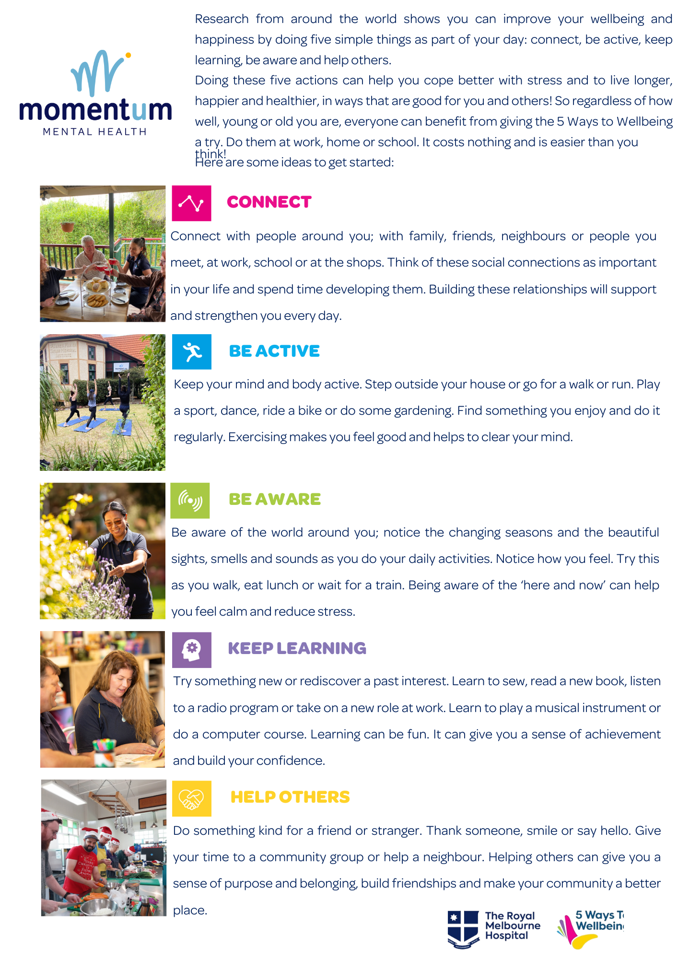
WELLBEING
SYMPOSIUM

Slide 39
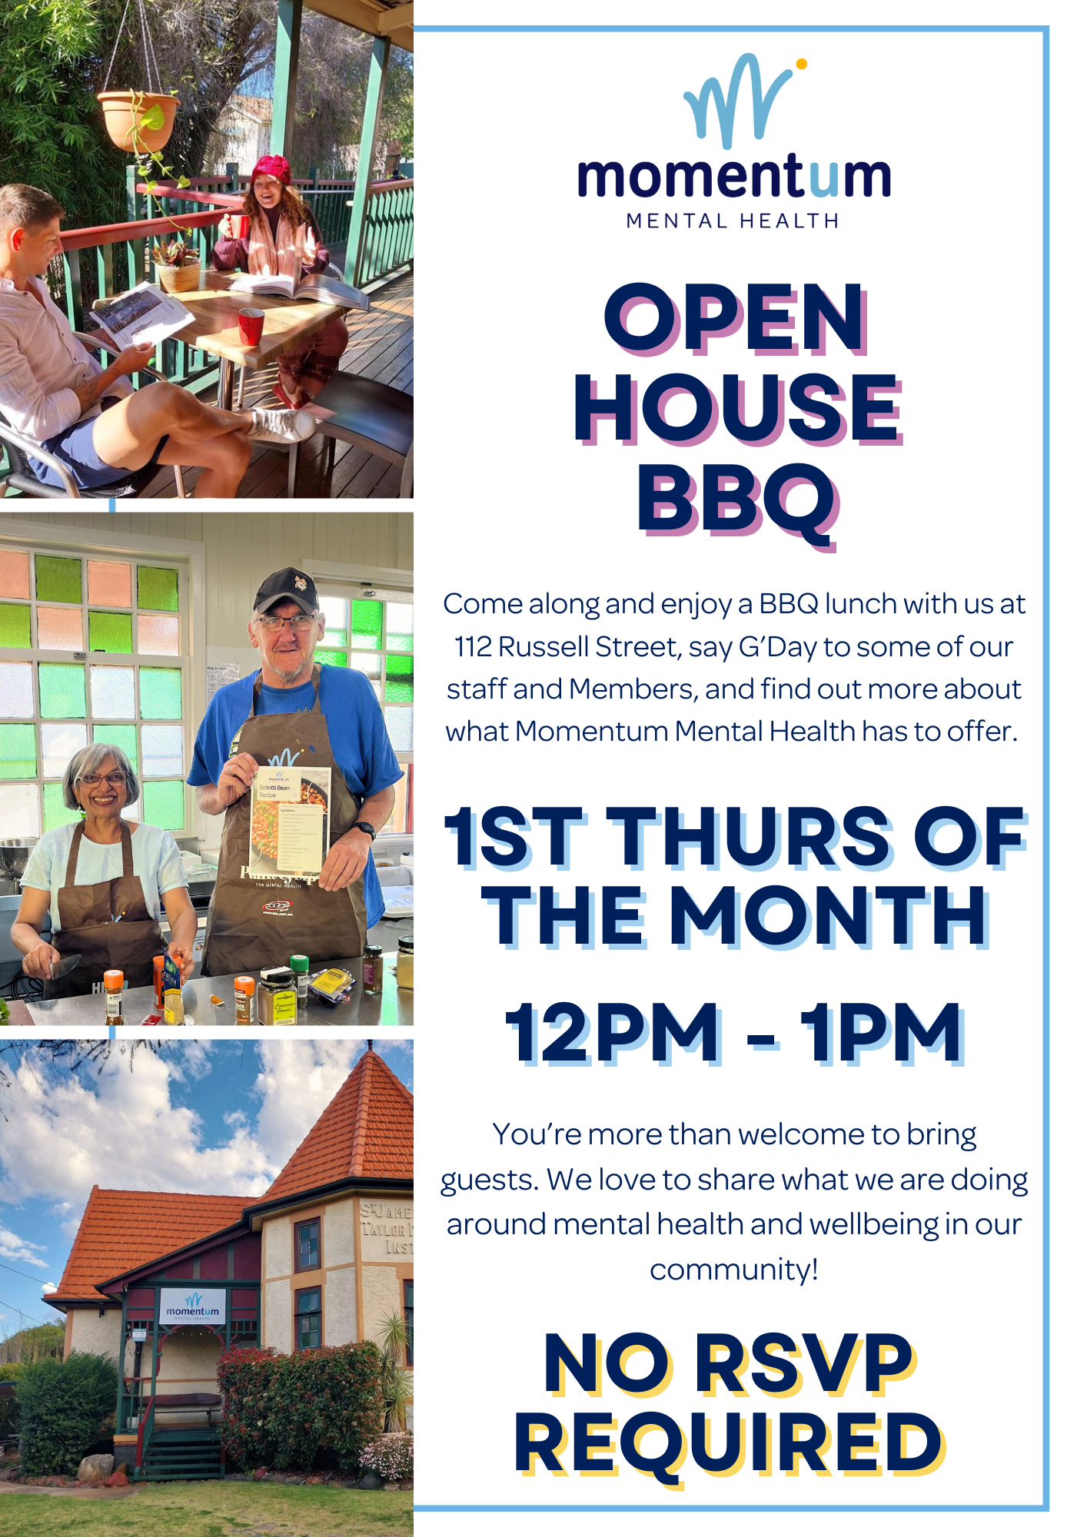

Slide 40
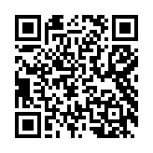
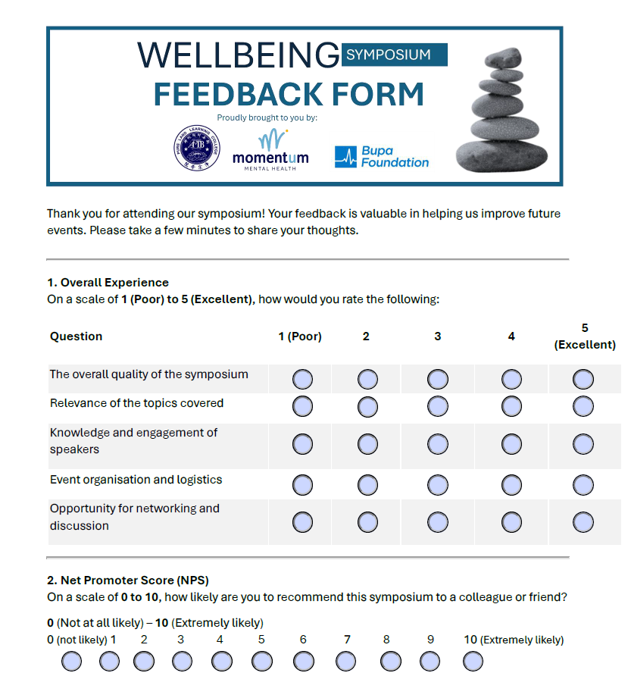
STAY IN TOUCH!
To stay connected with people from the event and to receive updates about future events, go to:
https://momentummentalhealth.com.au/symposium/
PROVIDE FEEDBACK
Don’t Forget to Complete the Feedback From!

